Slide 1
EL PROGRAMA DE PROMOCION JUVENIL MÁS AMBICIOSO
THE ITINERANT SCHOOL EXHIBITION,
THE LONGEST PEDAGOGICAL PROGRAM OF CORREOS AND FESOFI
1998 – 2017

Slide 2
IN 1998 THE DIRECCION DE FILATELIA OF CORREOS AND THE FEDERACION ESPAÑOLA DE FILATELIA, THROUGH THEIR YOUTH COMMISSION, DECIDED TO INITIATE A PEDAGOGICAL PROGRAM OF COLLABORATION WITH THE FOLLOWING OBJECTIVES:
PROMOTE THE USE OF POSTAL MAIL AND STAMPS
TEACH THE CULTURAL VALUE OF STAMPS
PROMOTE THE PHILATELY AT SCHOOLS

Slide 3
IN 19 YEARS MORE THAN
500.000 STUDENTS OF DIFFERENT AGES
HAVE PARTICIPATED IN THE PEDAGOGICAL PROGRAM
IN TWO PERIODS
FIRST :
“MAIL BETWEEN SCHOOLS” and “LA ITINERANTE “ (1.998 – 2.005)
SECOND :
SCHOOL EXHIBITION “THE WORLD OF STAMSP”
(1.998 – 2.005)

Slide 4
FIRST PERIOD (1998-2005)
“LA CORRESPONDENCIA EPISTOLAR”
MAIL BETWEEN SCHOOLS
IN COLABORATION WITH THE SPANISH EDUCATION MINISTRY

Slide 5
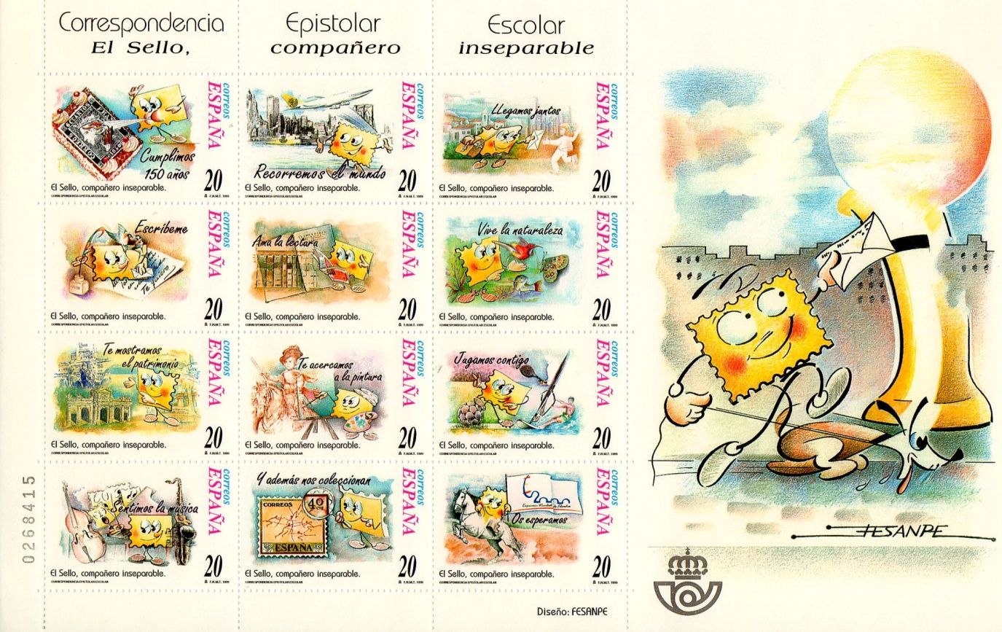
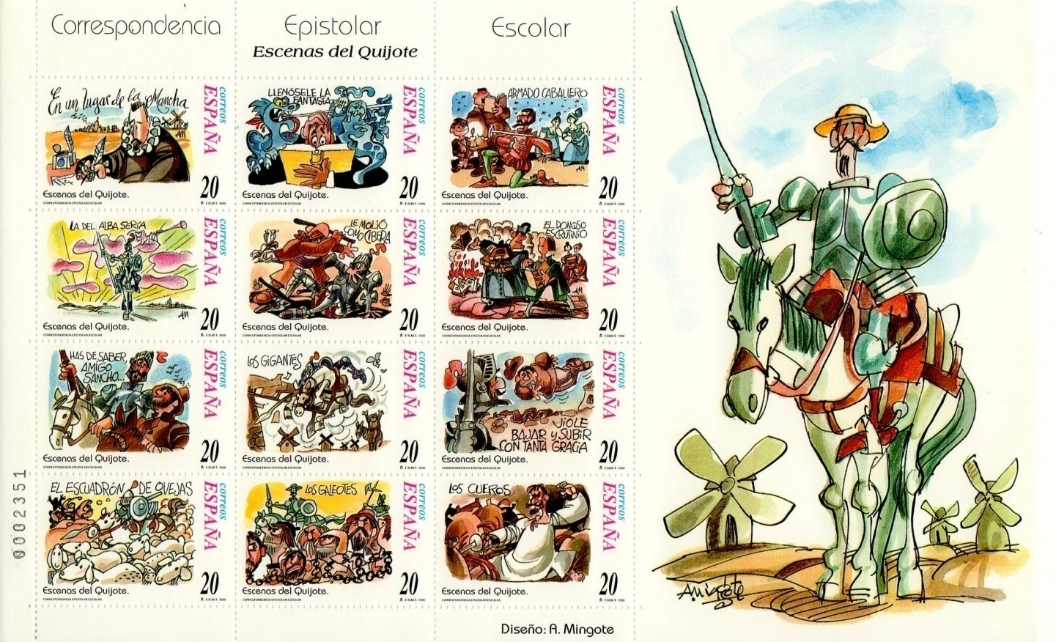
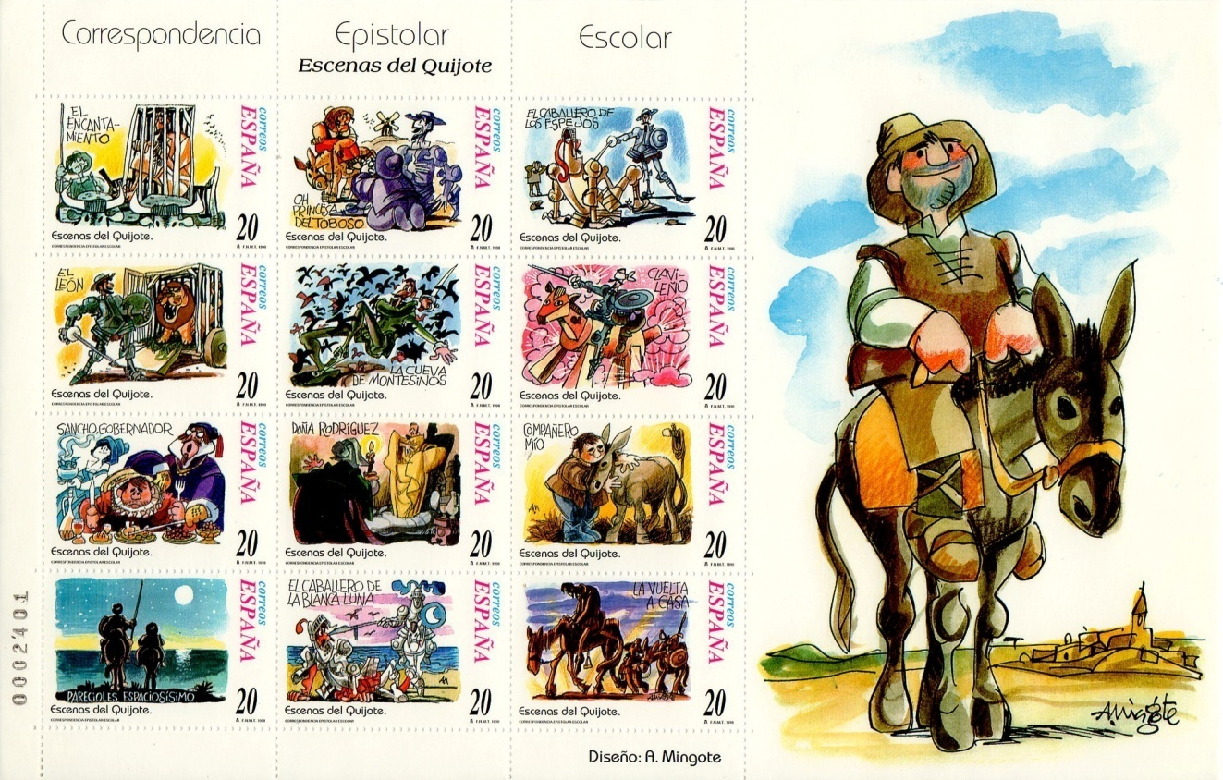
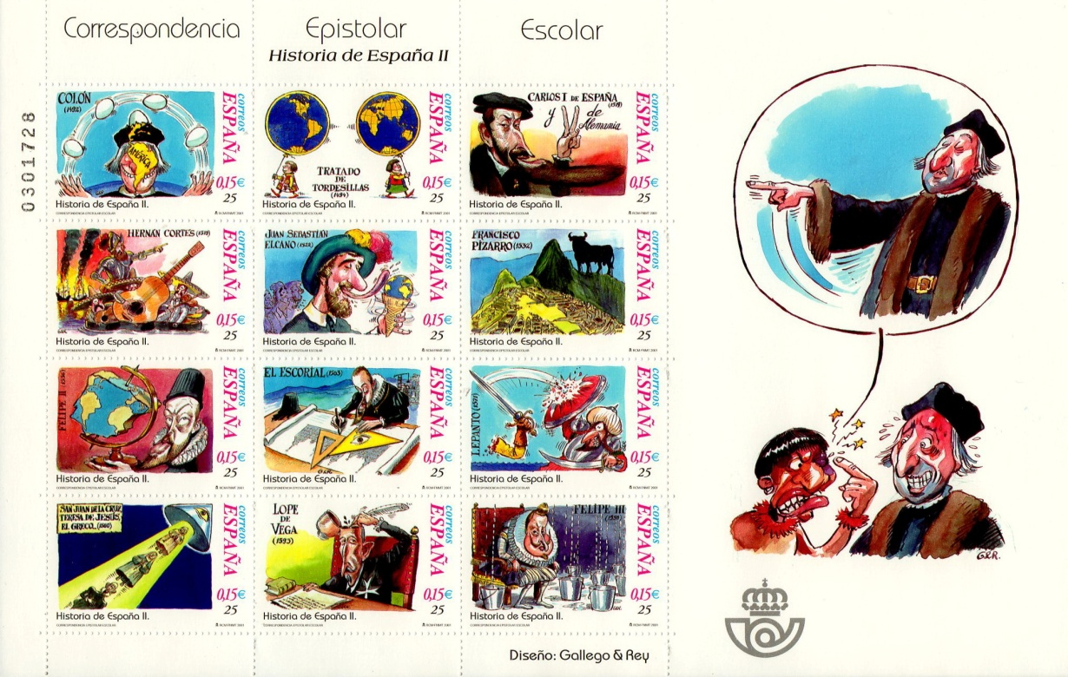
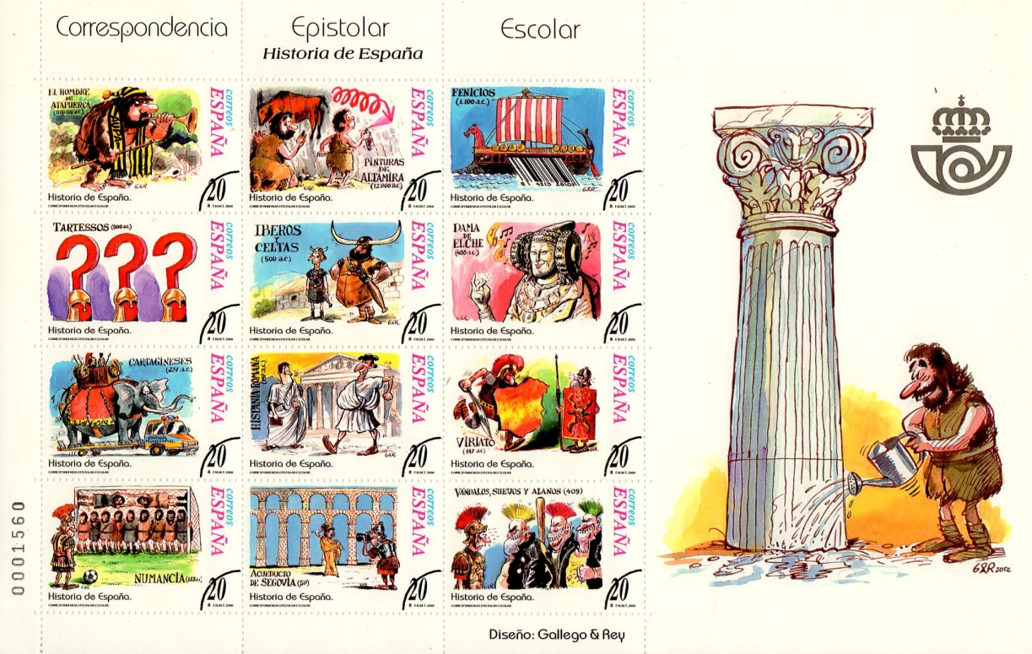
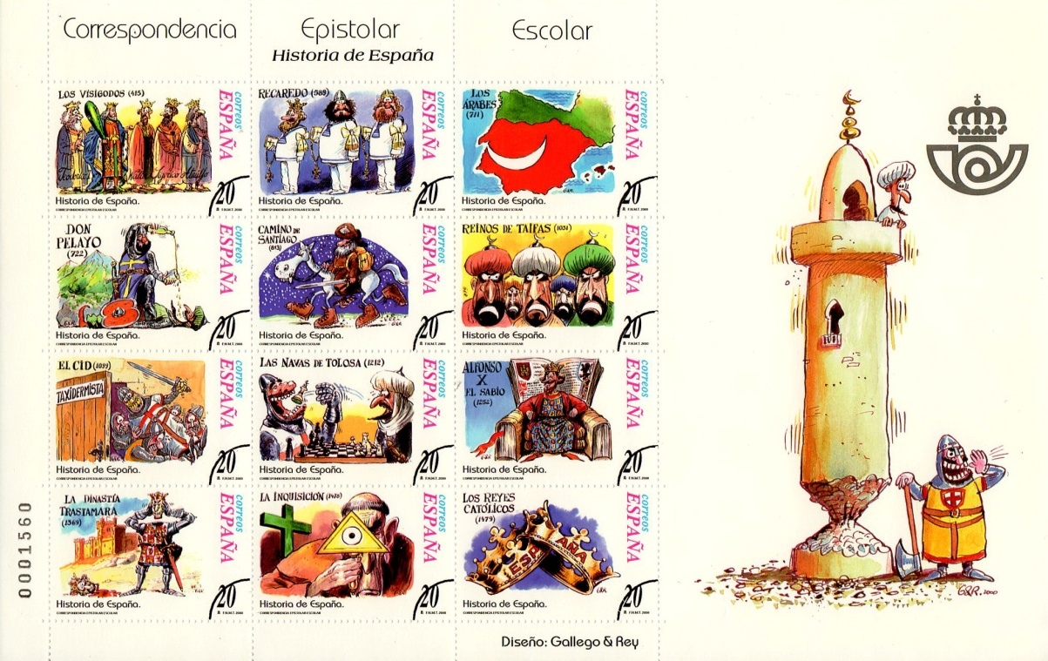
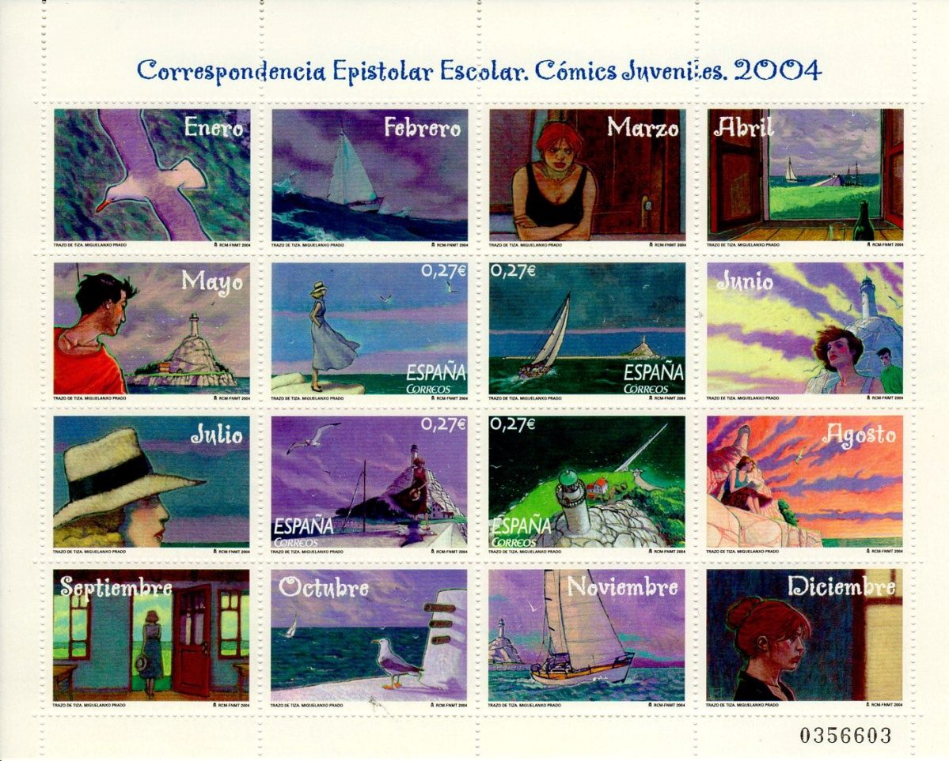
“LA CORRESPONDENCIA EPISTOLAR”
MAIL BETWEEN SCHOOLS
CORREOS APPROVE AN SPECIAL RATE FOR THE MAIL BETWEEN STUDENTS WHEN THE ADRESS IS THE SCHOOL
50 % DE DISCOUNTS (In 1998 20 Pta instead 40 ptas)
IN 7 YEARS CORREOS ISSUE 88 STAMPS FOR SCHOOLS TARIF
(TOTAL 186.400.000 STAMPS IN 8 FOLDERS)

Slide 6
“LA CORRESPONDENCIA EPISTOLAR”
MAIL BETWEEN SCHOOLS
CORREOS AND FESOFI’S YOUTH COMMISSION SEND INFORMATIVE LETTERS TO 20.000 SCHOOLS
EACH YEAR YOUTH COMMISSION PREPARE ONE ALBUM FOR ALL YEAR’S CANCELED STAMPS WITH PRIZE AWARDS FOR THOSE WHO COMPLETE THEM
IN 8 YEARS ABOUT 4.500 SCHOOLS AND 200.000 STUDENTS HAVE PARTICIPED AT THIS PEDAGOGICAL PROGRAM
(Reports of Correos and Ministry Education)

Slide 7
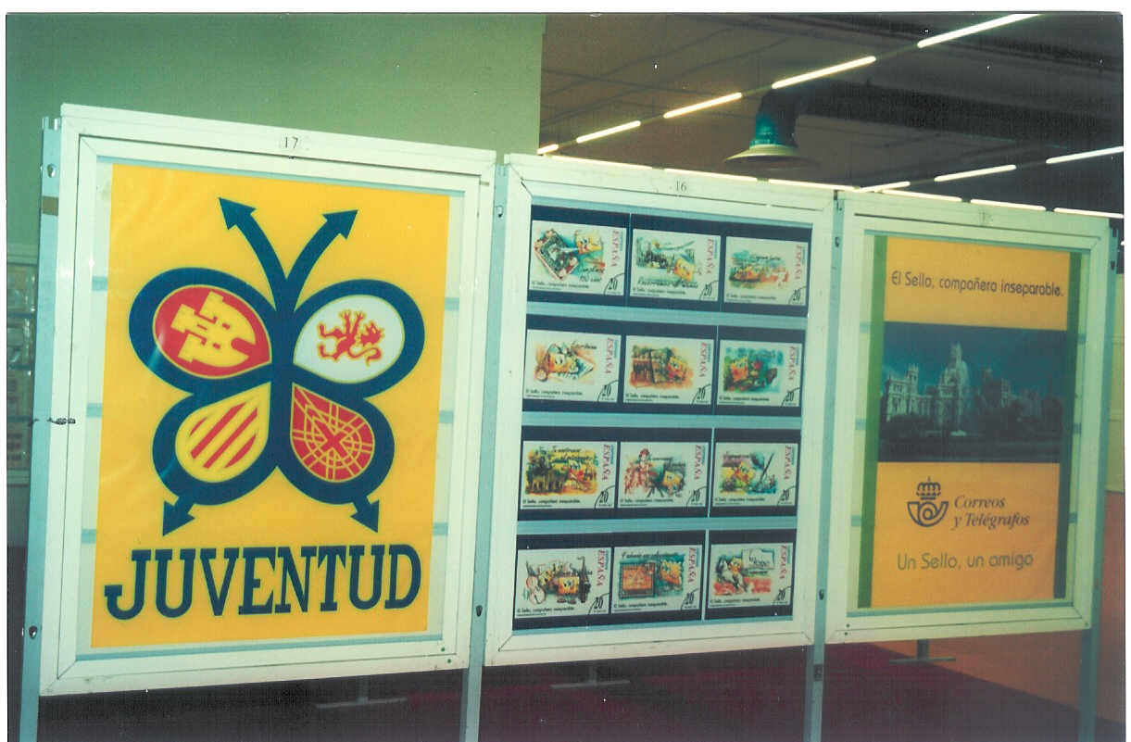
FIRST PERIOD (1998-2005)
“LA ITINERANTE”
SPONSOR: CORREOS
EXHIBITION OF 20 FRAMES WITH EXHIBITS DONATED FOR IMPORTANT PHILATELISTS, SCHOOLS OR PHILATELIC SOCIETIES AND A “DIDACTIC EXHIBIT” OF 5 FRAMES
THE EXHIBITIONS WERE HELD IN MUSEUMS, HOUSES OF CULTURE, CITY TOWNS, COMMUNITY CENTERS …

Slide 8
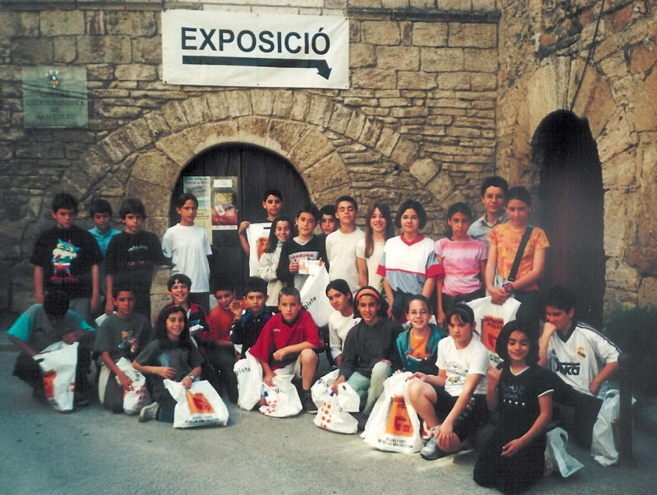
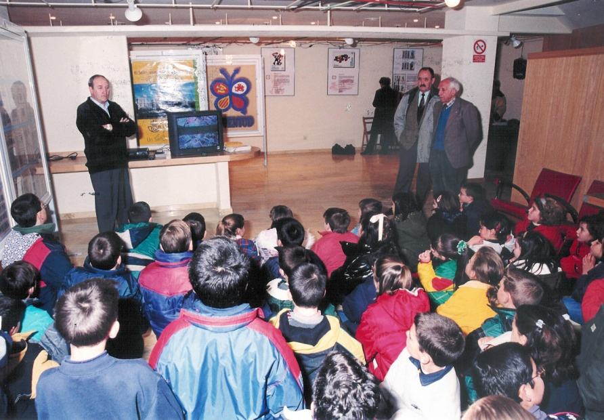
FIRST PERIOD (1998-2005)
“LA ITINERANTE”
SPONSOR : CORREOS
THE STUDENTS FROM LOCAL SCHOOLS VISITED THE EXHIBITION BUILDING
THE EXHIBIT REMAINED ONE WEEK AT EACH CITY
FESOFI’S YOUTH COMMISSION ORGANICED THE EXHIBITION EACH WEEK
ONE (OR TWO) NATIONAL FESOFI’S MONITOR WERE ALWAYS TEACHING AND MAKING WORKSHOPS

Slide 9
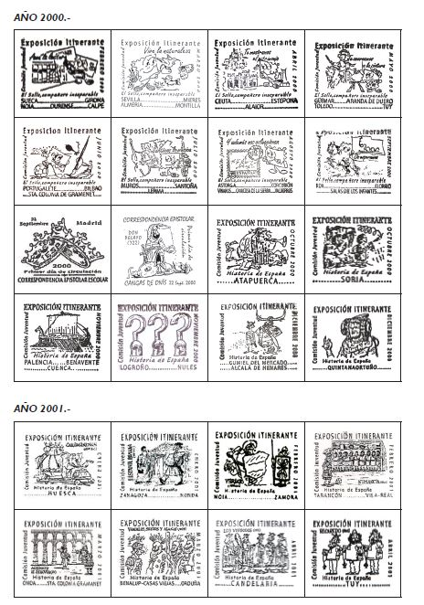
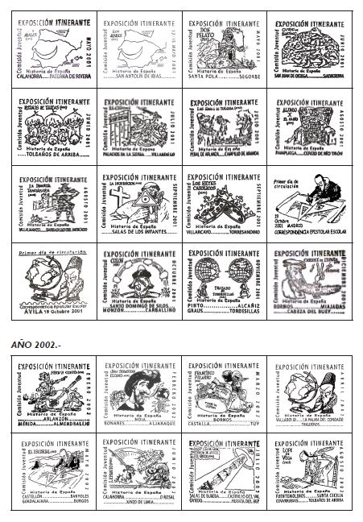
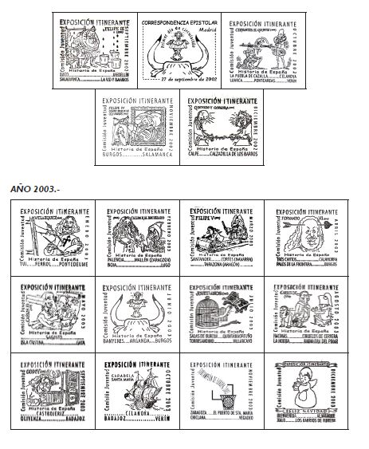
FIRST PERIOD (1998-2005)
“LA ITINERANTE”
SPONSOR: CORREOS
FROM 1998 YOUTH COMMISSION SETS AN AUXILIARY POST OFFICE WITH ITS OWN CANCELLATION
CANCELLATIONS AND STAMPS WITH SPECIAL POSTAL RATES WERE ISSUED TO EXCHANGE MAILS BETWEEN SCHOOLS MONTHLY
96
SPECIAL CANCELLATIONS IN 8 YEARS

Slide 10
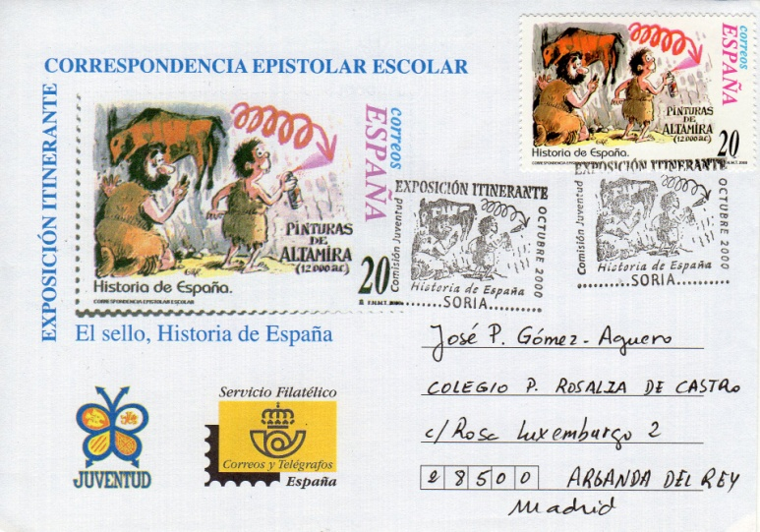
FIRST PERIOD (1998-2005)
“LA ITINERANTE”
SPONSOR : CORREOS
ITINERANTE
SPECIAL
CANCELLATION
SCHOOL’S TARIF STAMP
ONLY FOR STUDENTS AND TEACHERS
ONLY FOR SCHOOL ADRESSES

Slide 11
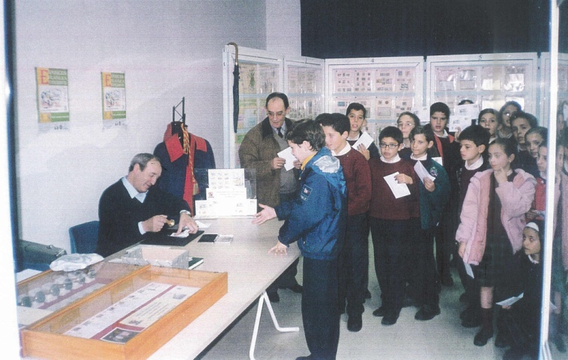
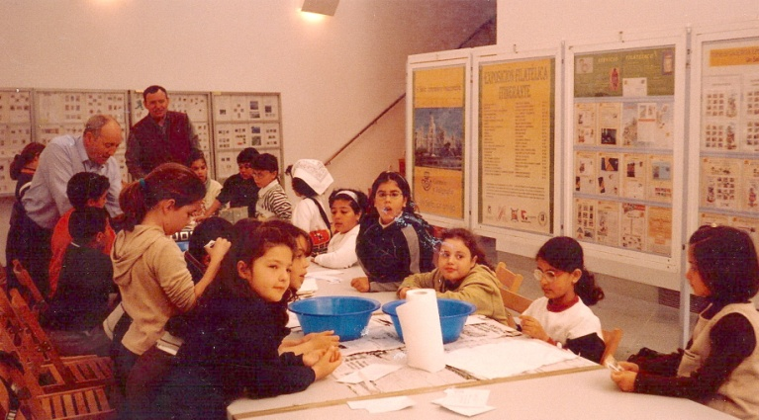
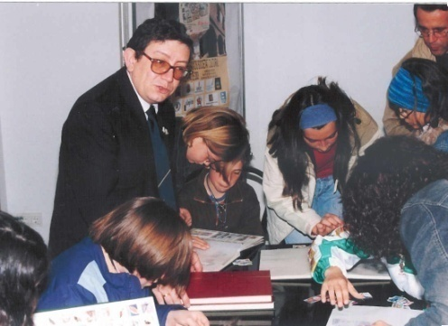
FIRST PERIOD (1998-2005)
“LA ITINERANTE”
IN 8 YEARS
259 TOWNS VISITED
(259 EXHIBITIONS)
903 SCHOOLS
124.167 STUDENTS (1)
6.121 TEACHERS (1)
About 25.000 adults
(1) From weekly reports

Slide 12
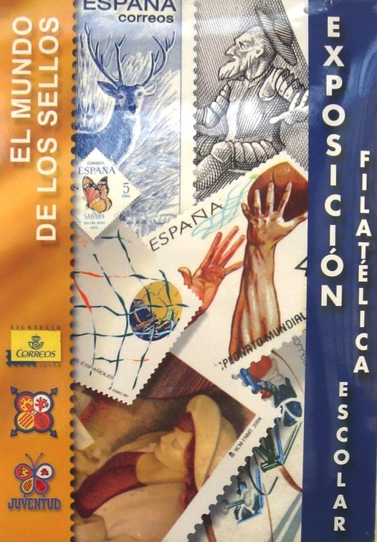
SECOND PERIOD (2006-2017)
SCHOOL EXHIBITION “THE WORLD OF STAMPS”
Exposición Escolar
“El Mundo de los Sellos”

Slide 13
SECOND PERIOD (2006-2017)
SCHOOL EXHIBITION “THE WORLD OF STAMPS”
CHANGE OF PHILOSOPHY
THE EXHIBITION GO TO SCHOOLS (Not at city buildings)
PROMOTION OF COMPUTER ACTIVITIES
NEW EXHIBITS (MORE DIDACTIC AND ILLUSTRATED)
PERSONALIZED STAMPS FOR EACH SCHOOL
SPECIAL ACTIVITIES FOR EACH AGE
DRAWING COMPETITION “ONE STAMP FOR MY TOWN”

Slide 14
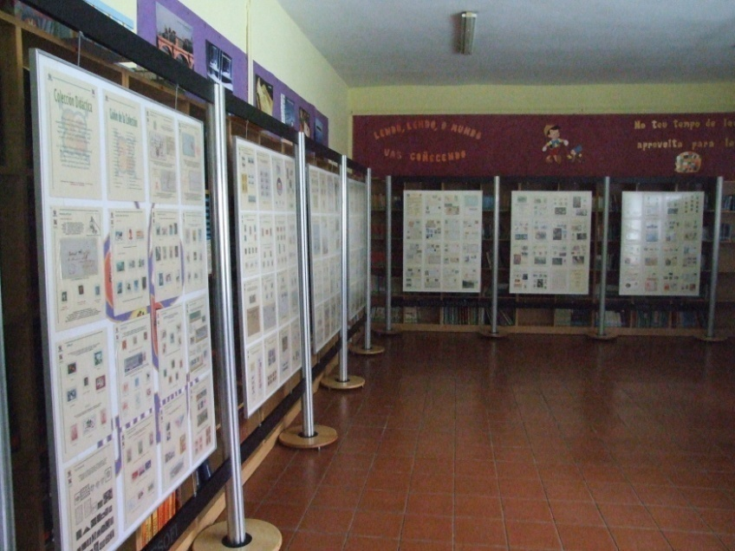
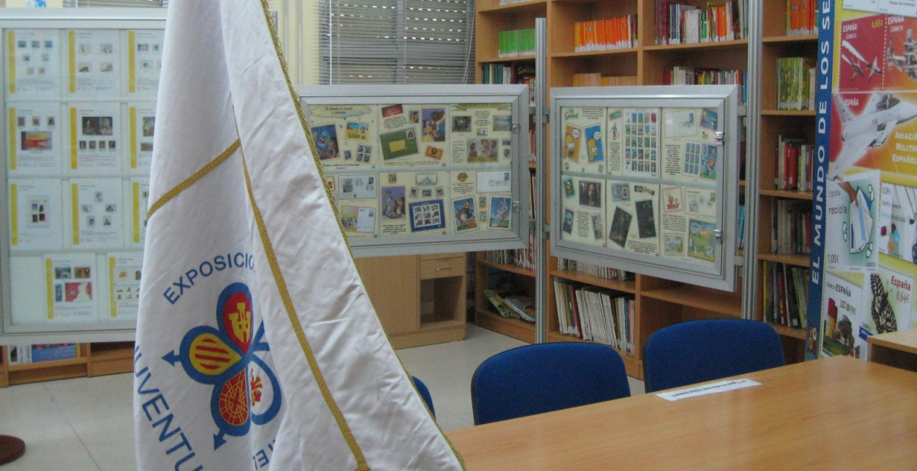
SECOND PERIOD (2006-2017)
SCHOOL EXHIBITION “THE WORLD OF STAMPS”
AT SCHOOLS
2006-2017
306 EXHIBITIONS IN 306 PUBLIC AND PRIVATE SCHOOLS
FROM 5 TO 18 YEARS

Slide 15
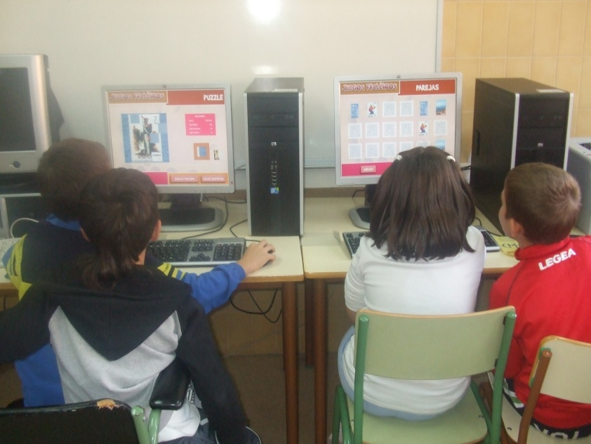
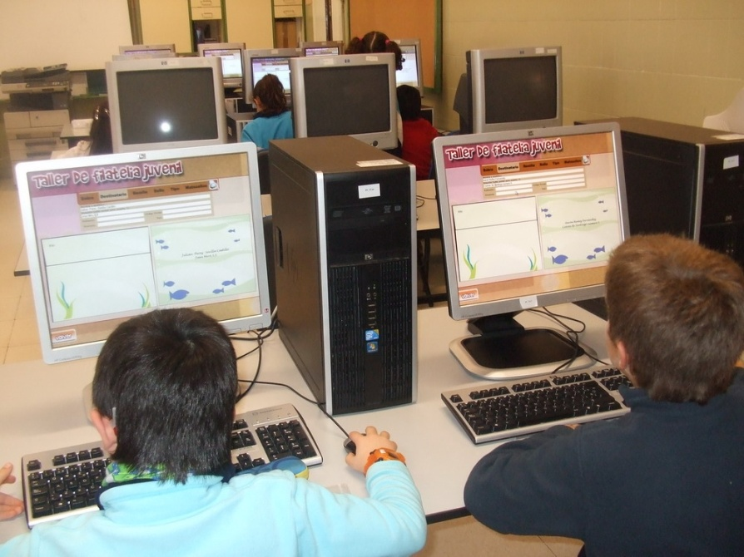
COMPUTER ACTIVITIES
59.000 copies distributed
CD STUDENTS
10 EDITIONS

Slide 16
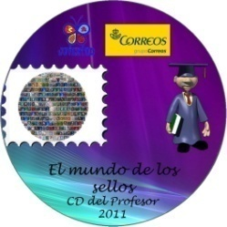
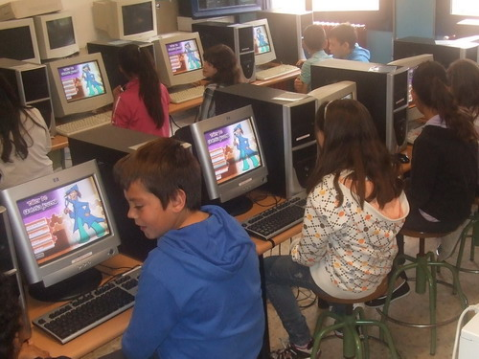
COMPUTER ACTIVITIES
CD TEACHERS
7 EDITIONS
WITH DIDACTIC CLASS SCHEDULES BASED ON STAMPS
8.000 copies

Slide 17
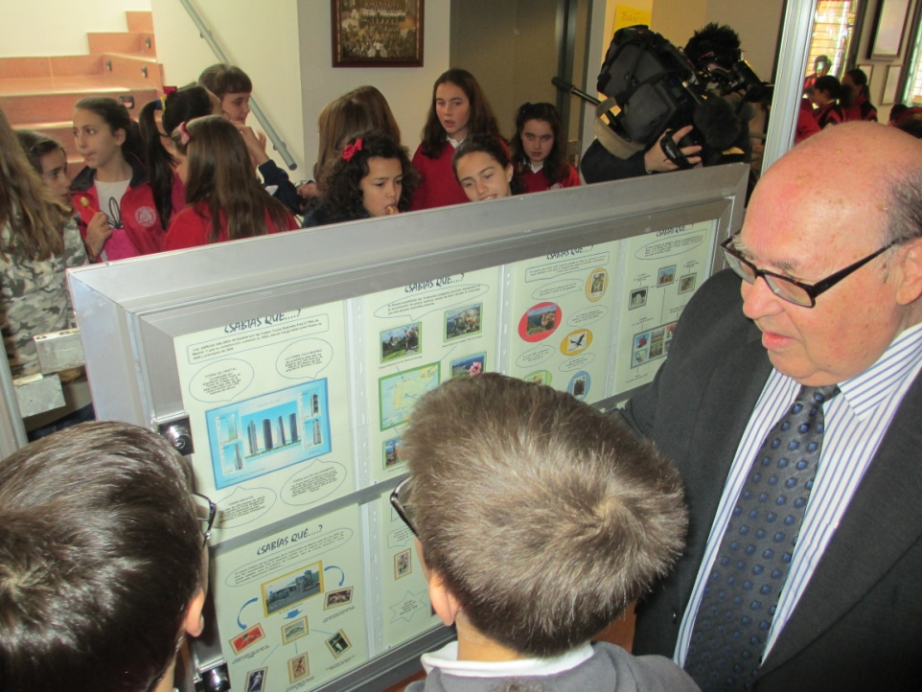
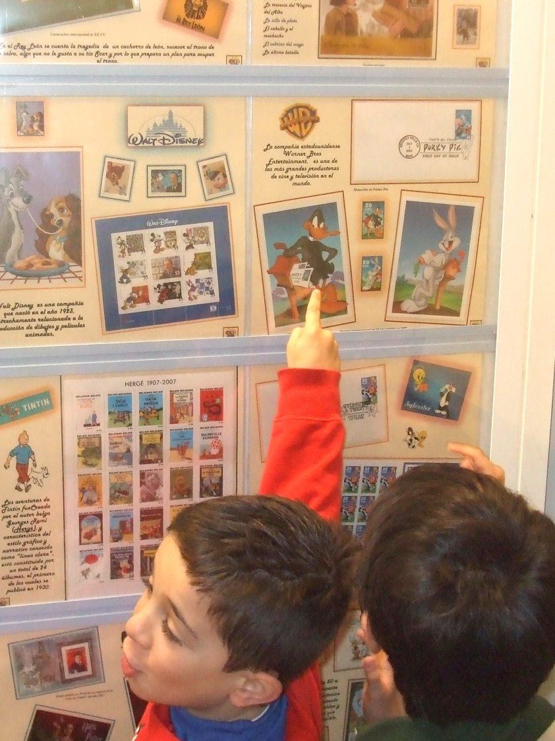
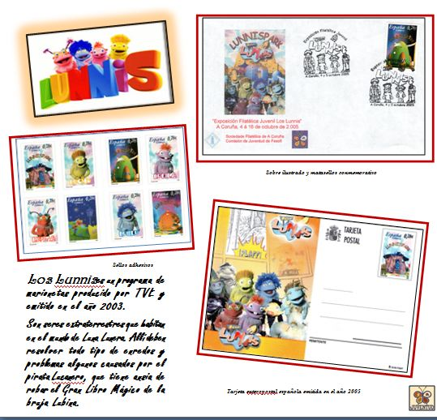
NEW ATTRACTIVE EXHIBITS

Slide 18
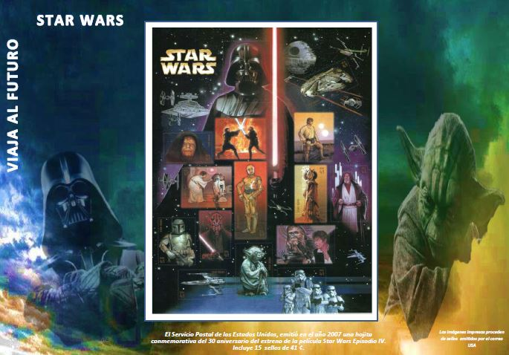
NEW ATTRACTIVE EXHIBITS
THE NEW EXHIBITS TALK ABOUT
HISTORY OF THE POST AND PHILATELY
THE STAMPS A WORLD OF ADVENTURES
THE MAIL ALWAYS COMES
INNOVATION IN STAMPS
DO YOU KNOW
AND MUCH MORE……

Slide 19
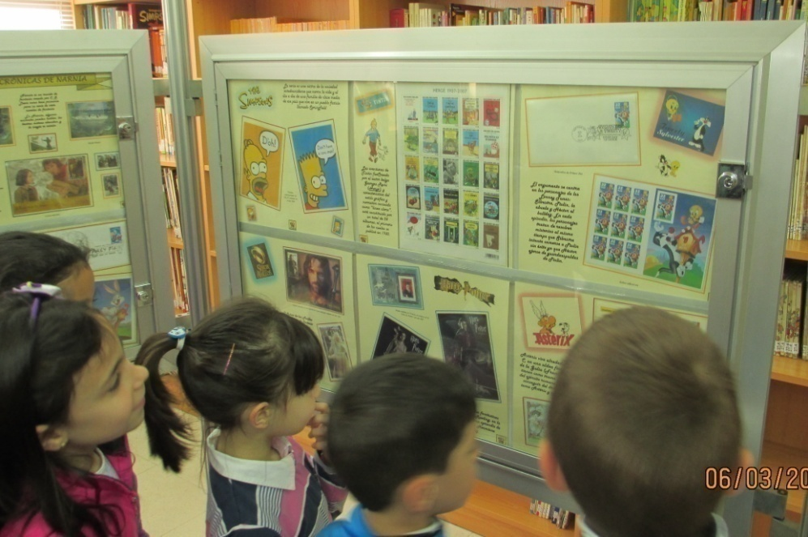
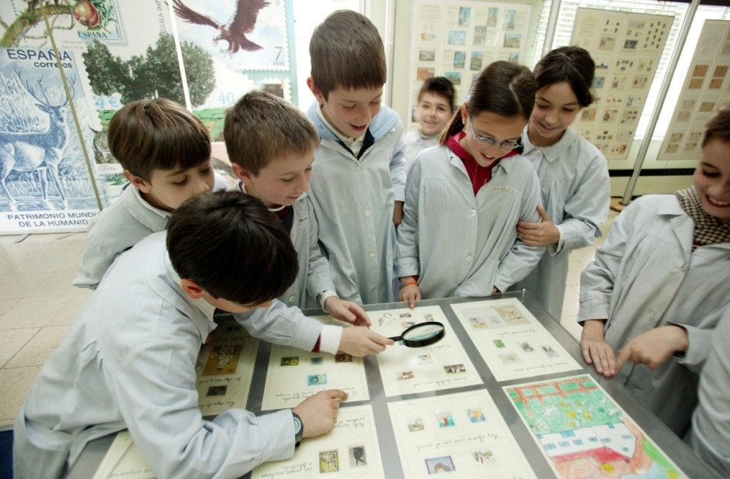
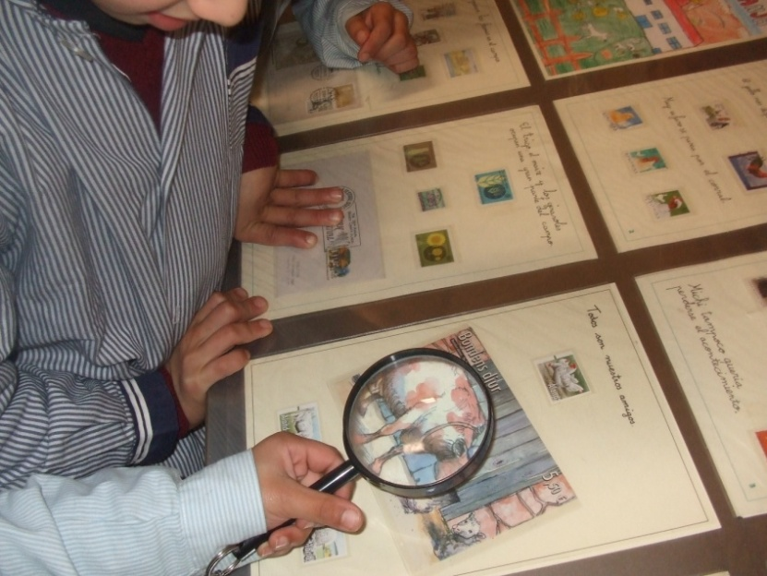
SPECIAL FRAMES AND PUPITERS FOR THE SMALLEST
With Exhibits made in public schools for 6/8 year old

Slide 20
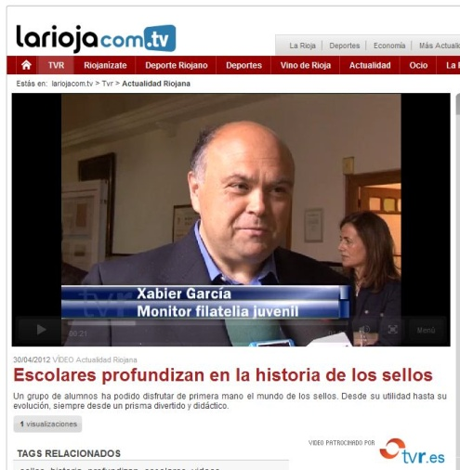
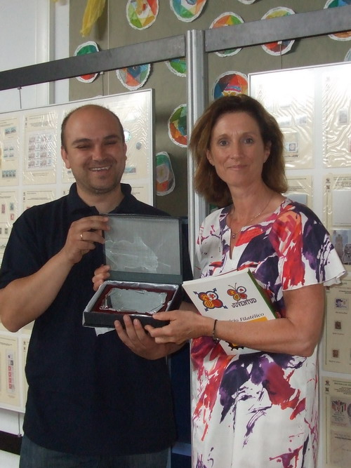
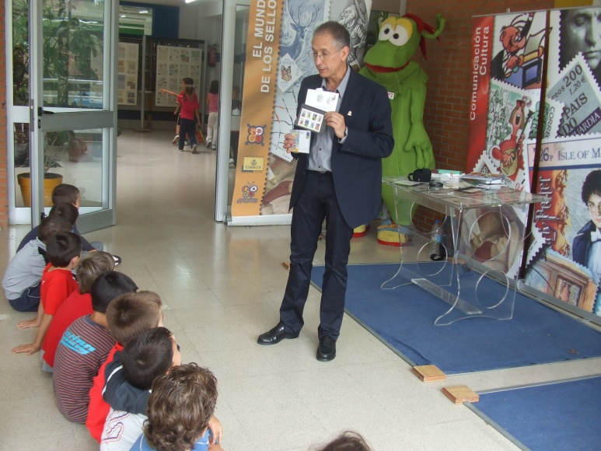
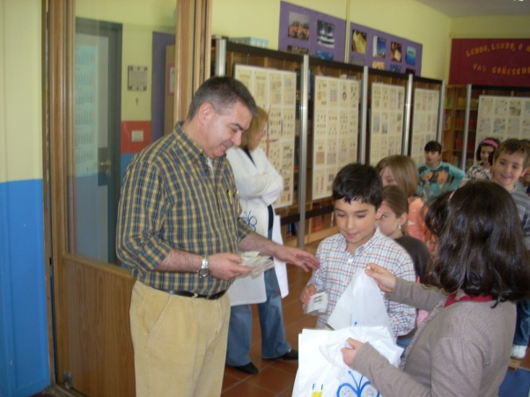
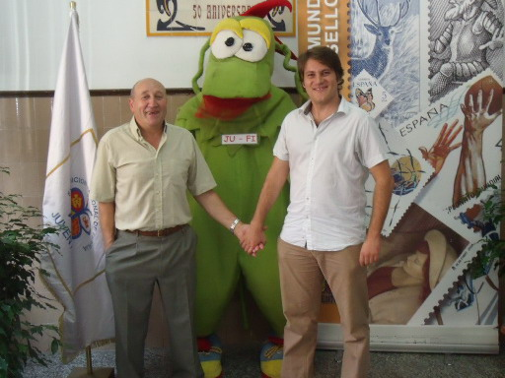
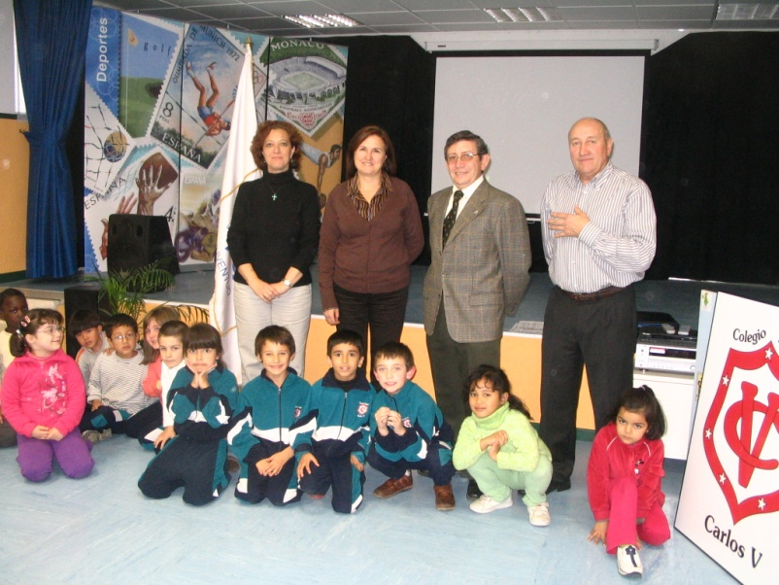
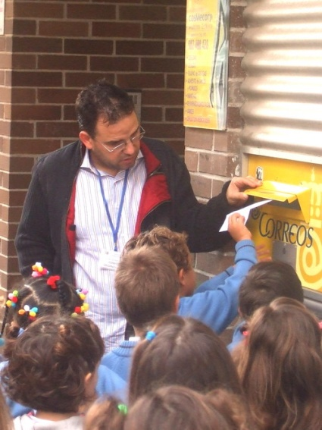
A DREAM TEAM OF 7 NATIONAL FESOFI’S YOUTH PHILATELIC MONITORS

Slide 21
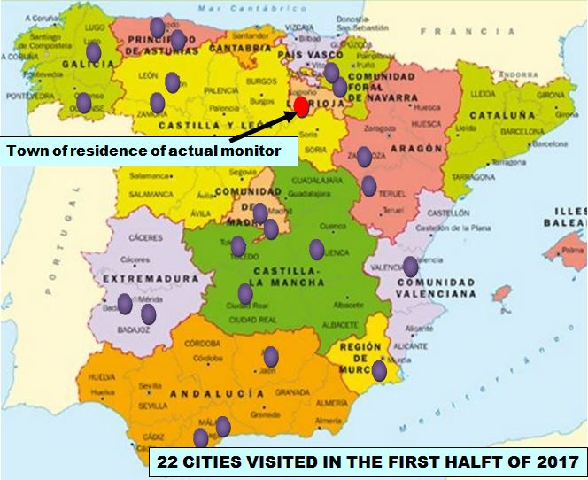
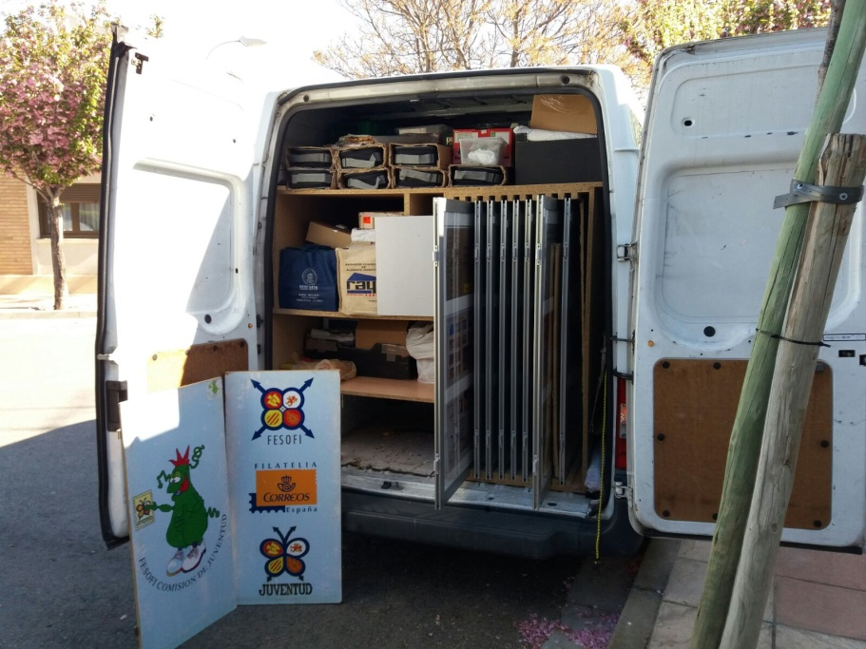
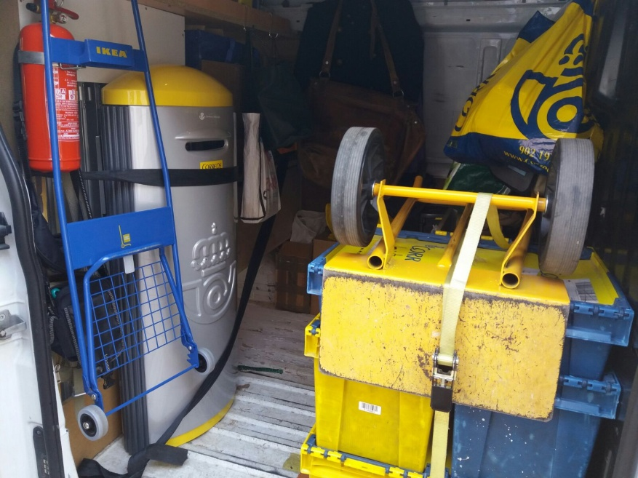
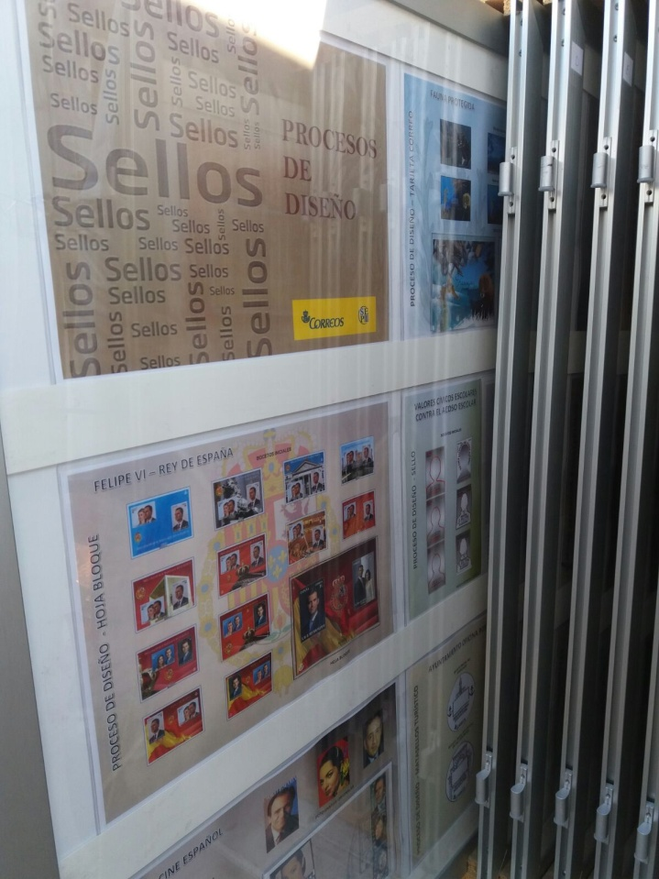
ABOUT 30.000 KMS OF TRAVEL EACH YEAR

Slide 22
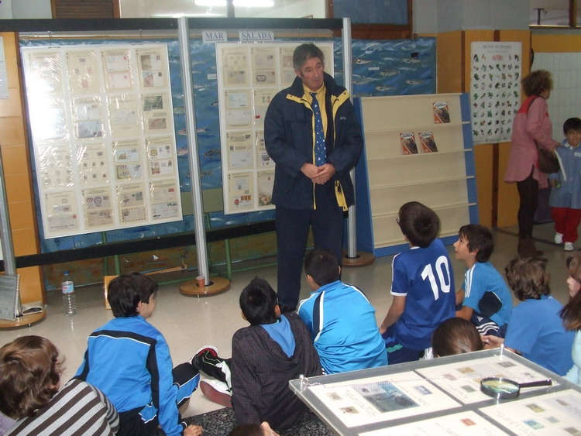
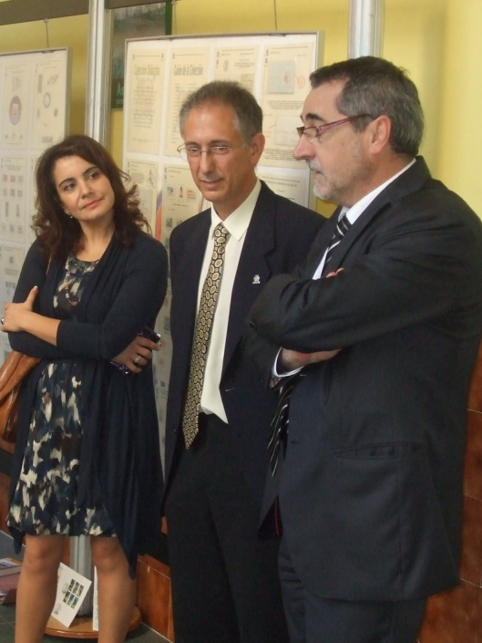
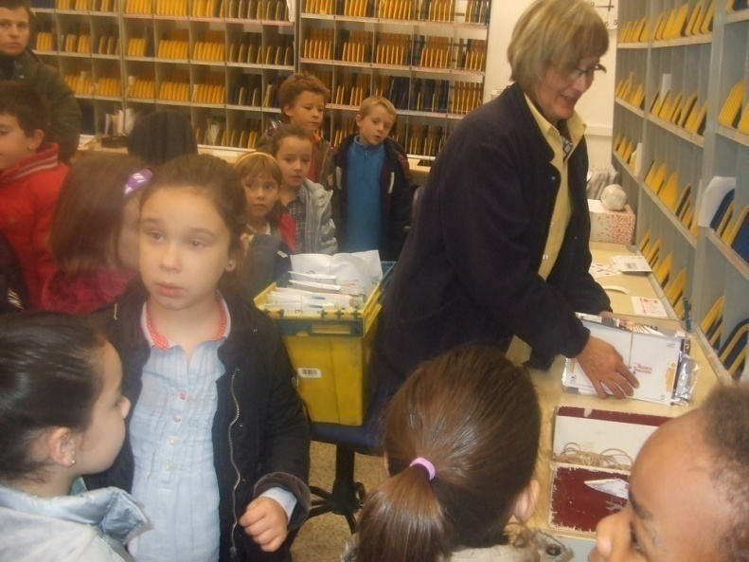
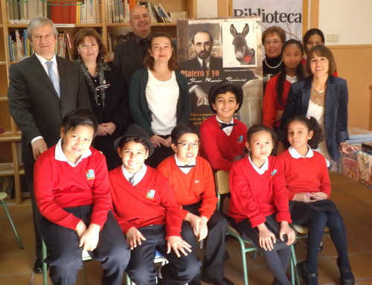
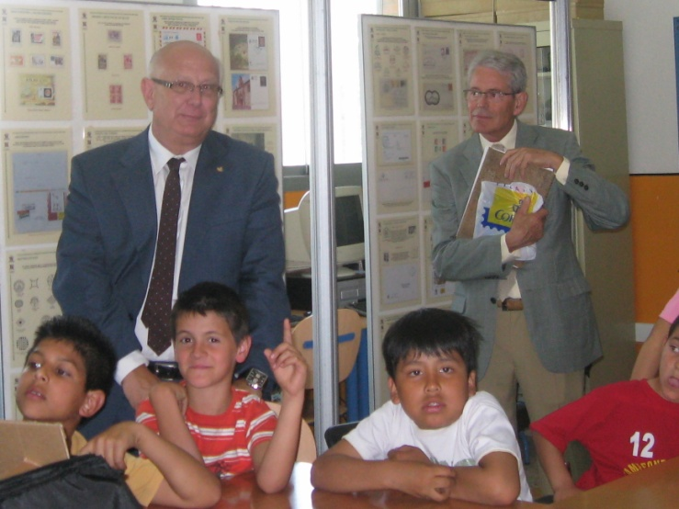
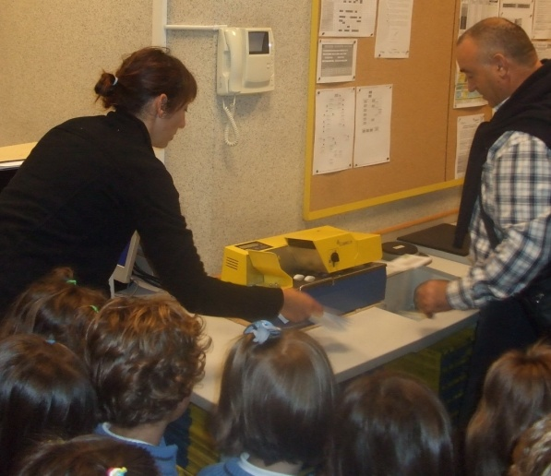
FULL SUPPORT OF CORREOS
With the President
of Spanish Post

Slide 23
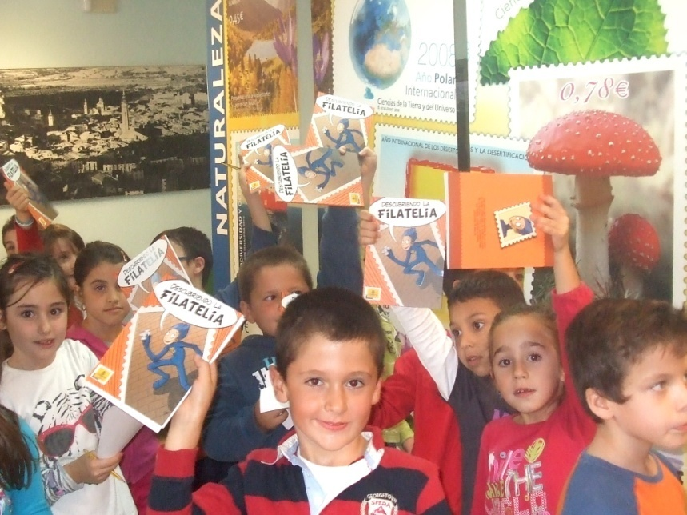
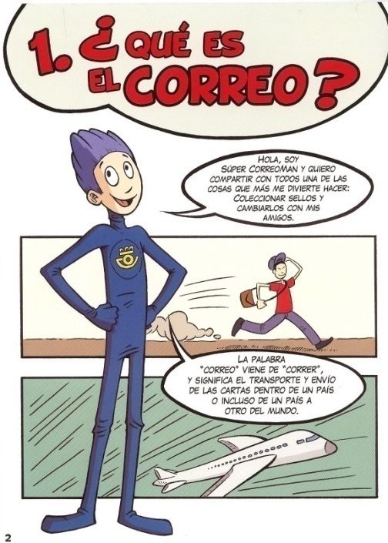
COMIC’S FOR EACH LEVEL SPONSORED BY CORREOS
25.000 Copies of each one

Slide 24
Spanish Territorial Philatelic Federations and local Philatelic Societies colaborate

Slide 25
THOUSANDS AND THOUSANDS OF GIFTS
CD’s
Rules,
comics
magnifiers
T-shirts
covers,
pins,
and…

Slide 26
EACH YEAR 300.000 STAMPS PRE-CANCELED BY Real Fabrica Nacional de la Moneda y Timbre (Royal National Stamps and Coins Factory)
So each student can prepare his
FIRST ALBUM

Slide 27
MORE ACTIVITIES IN “The world of stamps”
Workshops
Visit to Post Offices
Competitions
Visits to philatelic Exhibitions
And… much more
Homing pigeons

Slide 28
FROM 2013 NEW ENCOURAGEMENT:
PERSONALIZED STAMPS FOR SCHOOLS

Slide 29
EACH SCHOOL HAS THREE PERSONALIZED STAMPS WITH PICTURES CHOSEN BY THE CENTER
IN 5 YEARS 405 PERSONALIZED STAMPS (142 SCHOOLS) HAVE BEEN ISSUED

Slide 30
EACH STUDENT RECEIVES ONE COVER AND ONE STAMP TO SEND HIS FIRST LETTER
ABOUT 55.000 “TU SELLO” (Personalized stamps)

Slide 31
WEEKLY DRAWING COMPETITION
“ONE STAMP FOR MY TOWN”

Slide 32
THE WINNER OF EACH SCHOOL RECEIVES ONE FOLDER WITH “HIS STAMP” IN AN OFFICIAL CEREMONY
105 DRAWING COMPETITIONS
IN THE LAST 4 YEARS

Slide 33
INFORMATION IN MEDIA PRESS
MORE THAN
2000 references in MEDIA (TV, radio, Press e internet

Slide 34
INFORMATION AT WWW.FESOFI.ES

Slide 35
SUMMARY OF THE SECOND PERIOD
2006-2017 (May)
128.518 STUDENTS
6.950 TEACHERS
306 SCHOOLS
302 TOWNS
30/36 EXHIBITIONS/YEAR

Slide 36
THIS IS ONLY POSSIBLE THANKS TO CORREOS’ SPONSORSHIP
AND THE WORK OF MANY PHILATELISTS

Slide 37
THANK YOU FOR YOUR TIME … AND…

