Slide 1
PICTURE POSTCARDS
FEPA Seminar
PRAHA 2018
International Exhibition
17 August 2018
Birthe King

Slide 2
FEPA Picture Postcards Regulations
Many European countries have included postcards at their local and national exhibitions for many years with more accepting this class recently. The FEPA Board felt that it would be both encouraging and helpful to promote a Picture Postcard Class at European level to enable collectors to exhibit across national boundaries using the same competition criteria.
The aim was to keep the Regulations to four pages, to keep them as simple as possible, to encourage Picture Postcard exhibitors, and not to be restrictive.
So now we have:
Special Regulations for the Evaluation of Picture Postcard Exhibits
at FEPA Exhibitions, Athens 15 November 2015

Slide 3
Definition of a Picture Postcard
A picture postcard must have an illustration.
Gruss Aus postcard

Slide 4
Definition of a Picture Postcard
Used Picture Postcards (circulated through the postal service or in any other manner treated postally) must show that they have been through a postal service.
Reverse of the previous Gruss Aus card.

Slide 5
Definition of a Picture Postcard
Unused (non-postally treated) Picture Postcards must have printed text or printed address lines, for example a postage area, which shows that the card is meant to be posted without an envelope.

Slide 6
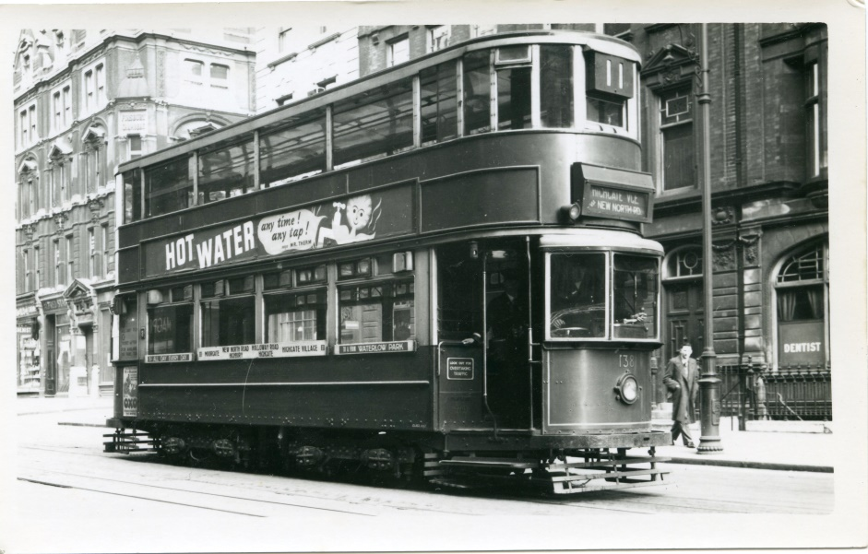
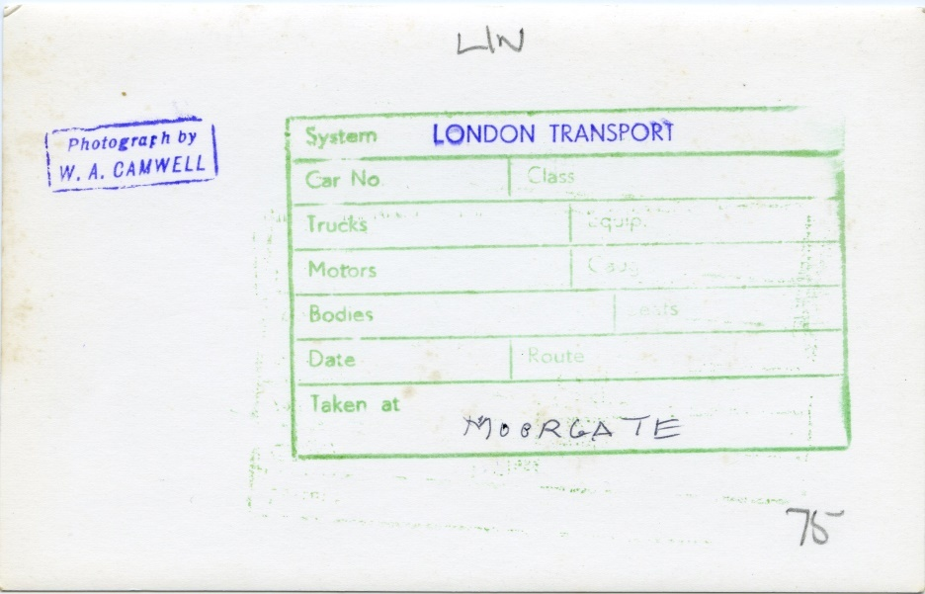
Definition of a Picture Postcard
Only original contemporary Picture Postcards are allowed, i.e. reprints produced at a later time should only be shown exceptionally.
This is not a Picture Postcard.
It has an illustration, but it was not meant to be sent through the post.

Slide 7
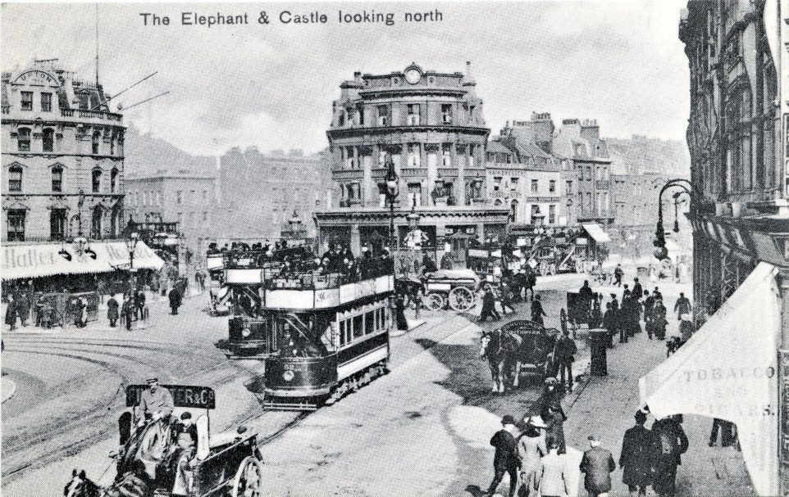
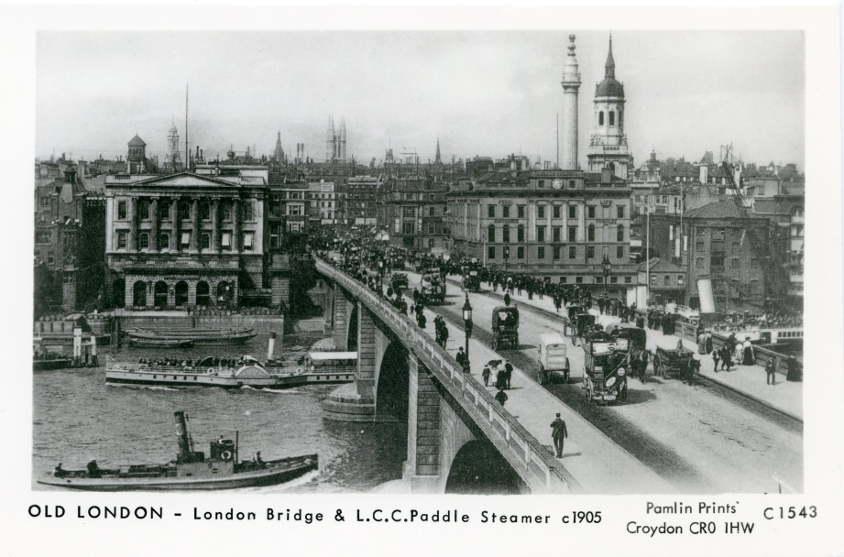
Definition of a Picture Postcard
Only original contemporary Picture Postcards are allowed, i.e. reprints produced at a later time should only be shown exceptionally.
London Borough of Southwark Pamlin Prints
Library & Museum Services Croydon Cro 1HW
Elephant & Castle, looking north, 1907

Slide 8
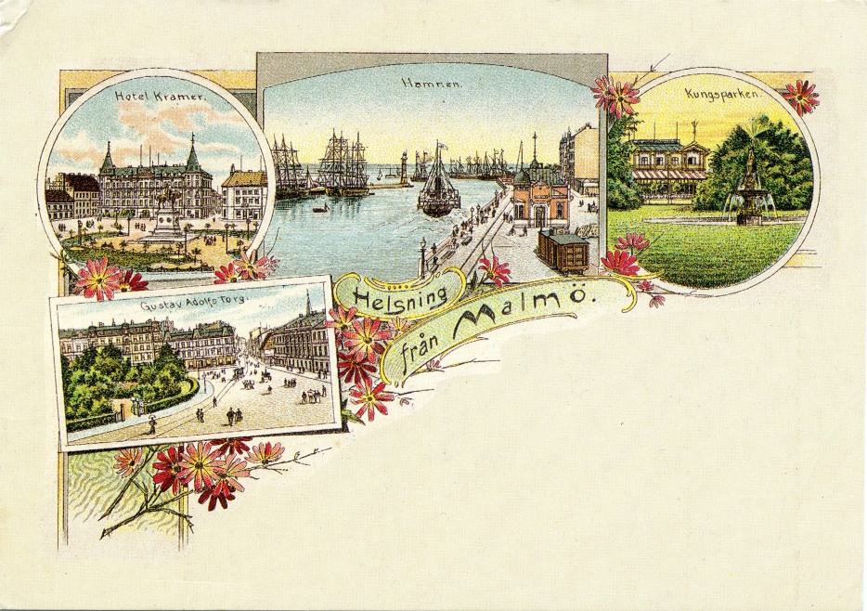
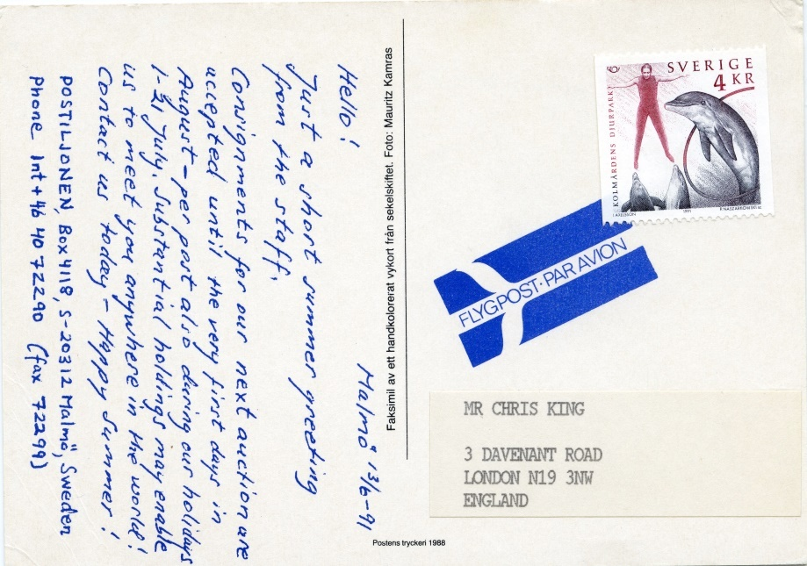
Definition of a Picture Postcard
Only original contemporary Picture Postcards are allowed, i.e. reprints produced at a later time should only be shown exceptionally.
A beautiful old Picture Postcard: Hälsning från Malmö?

Slide 9

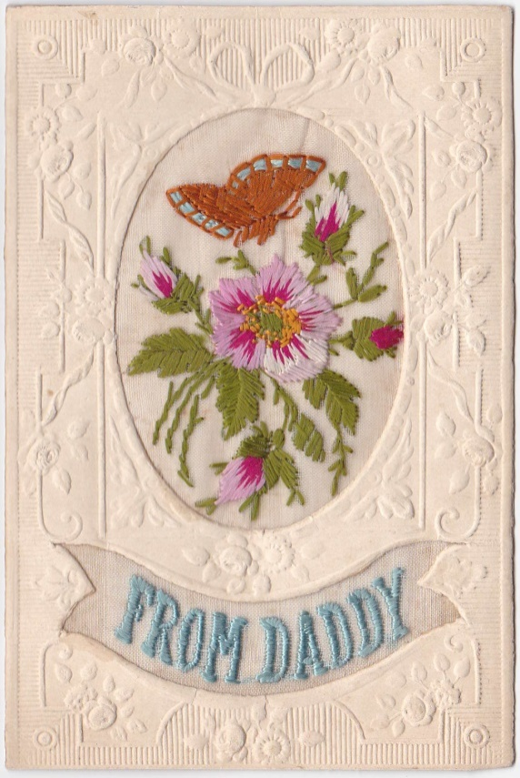
Definition of a Picture Postcard
A Picture Postcard may be produced by different kinds of material (hand drawn or printed, embroidered, etc.).
World War I embroidered silk cards
Courtesy of Graham Winters.

Slide 10
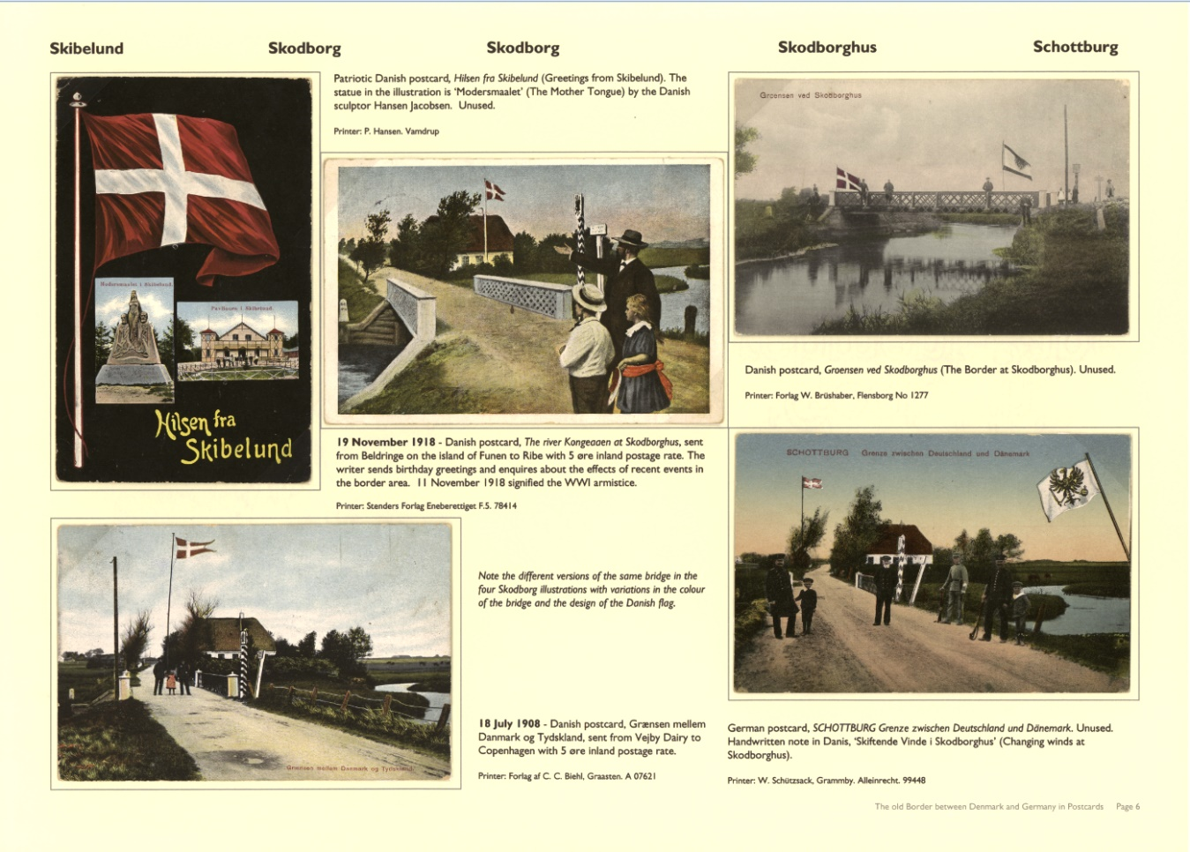
Definition of a Picture Postcard
The exhibit must be able to be displayed in exhibition frames of the standard international format of 16 A4 pages per frame or equivalent, e.g. A3.

Slide 11
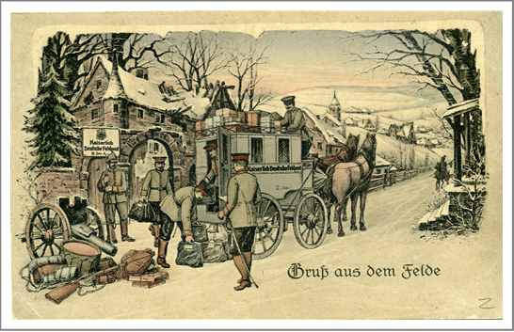
Definition of a Picture Postcard
Fieldpostcard sent 8 March 1915
‘Greetings from the field’
What is going on in the picture?
Mail carriage loading Fieldpost mail from the field post
Horses
People/Soldiers
Mailbags
Cannon
Drum
Bags
Text:
Kaiserlich Deutsche Feldpost

Slide 12
Principles for the Development of the Exhibit
Idea, Plan and Treatment
A Picture Postcard exhibit is treated according to a geographical (topographical) topic, a thematic topic, or according to a special aspect (an artist, the printing, the material), completely according to the exhibitor’s own choice.
Propaganda:
1920 Plebiscite in Slesvig election poster -
Mother Denmark in front of German eagle
Now Denmark calls her children home
Farewell forever you German eagle.

Slide 13
Principles for the Development of the Exhibit
Idea, Plan and Treatment
The title and plan must be presented on the introductory page and must be written in one of the official FIP languages. Courtesy of Francois Boeglin, France.

Slide 14
Principles for the Development of the Exhibit
Idea, Plan and Treatment
The plan must show the intention and the structure of the exhibit. The title as well as the main and sub sections of the exhibit must show the structure and logical development through the exhibit and demonstrate personal creativity, knowledge, and research. Courtesy of Jenny Long, New Zealand (left) and Martienss Rüdiger, Germany (right).

Slide 15
Principles for the Development of the Exhibit
Idea, Plan and Treatment
The title must mirror the content of the exhibit in the best possible way. The treatment of the exhibit must be according to the title and plan. Each Picture Postcard must have a connection with the chosen topic. Courtesy of Alan Pihl, Finland.

Slide 16
Principles for the Development of the Exhibit
Idea, Plan and Treatment
The variety (diversity) of the material is of particular importance.
Courtesy of Seija-Riitta Laakso.

Slide 17
Principles for the Development of the Exhibit
Knowledge and Research
Research is a pre-requisite for knowledge of the topic and the Picture Postcards, and this is demonstrated in a brief text with each Picture Postcard.
Typography, printing method, and printer
Routes and rates
Knowledge of the topic, for example the local town, its history, its people, etc.
The artist or photographer

Slide 18
Principles for the Development of the Exhibit
Knowledge and Research
The exhibitor is expected to show knowledge of the cards:
The texts must contain essential information about the topic,
and may contain information about the photographer or the artist, the printer or publisher.
If known, information about the issue date, the number in a set, the distribution method, etc. should be included.
Information about the typography and printing method may be demonstrated in a appropriate manner.
And finally, the bibliography should include references of any original research.

Slide 19
Production Methods/Techniques
Real Photographic Postcard
Silk (Woven & Embroidered)
Recess (Intaglio/Gravure) Printing
  Lithography Photolithography
  Chromolithography
  Collotype
Letterpress Printing - Half-tone Block
Four-colour process (Recess, Lithography & Letterpress)
Most of the following illustrations were kindly provided by David Figg, Australia, and appear in a presentation by Colin Hoffman at STAMPEX in London 2016.

Slide 20
Production Methods/Techniques
Real Photographic Post Card:
These are photographs which are easy to identify and may be black&white or coloured/tinted.

Slide 21
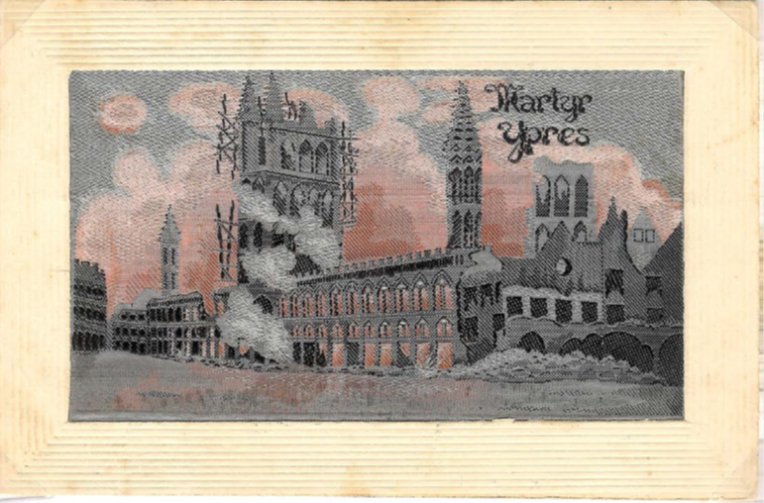
Production Methods/Techniques
Silk (Woven & Embroidered): Also easy to identify.

Slide 22
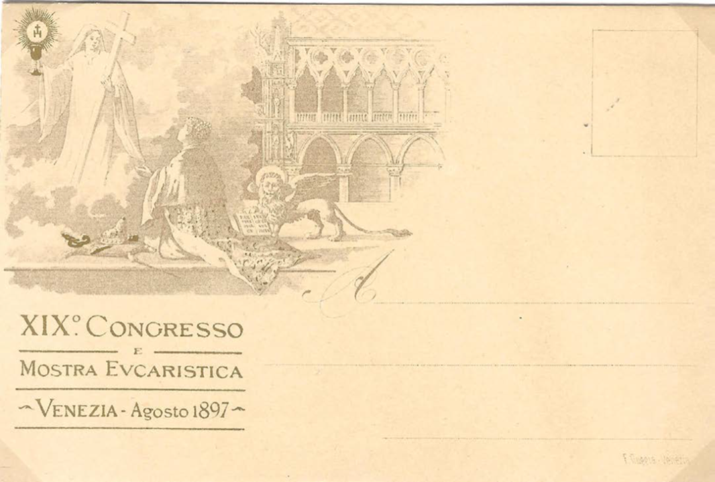
Production Methods/Techniques
Recess (Intaglio/Gravure) Printing

Slide 23
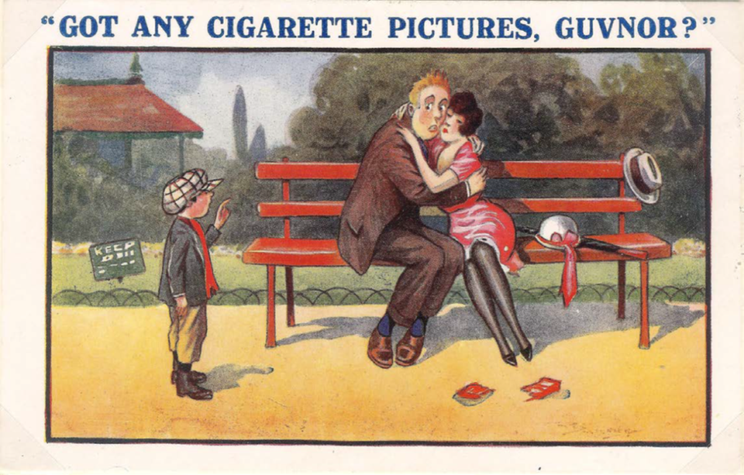


Production Methods/Techniques
  Lithography: Photolithography - looking for dots e.g. 120 dpi, 650 dpi
  5x magnified
  10x magnified

Slide 24
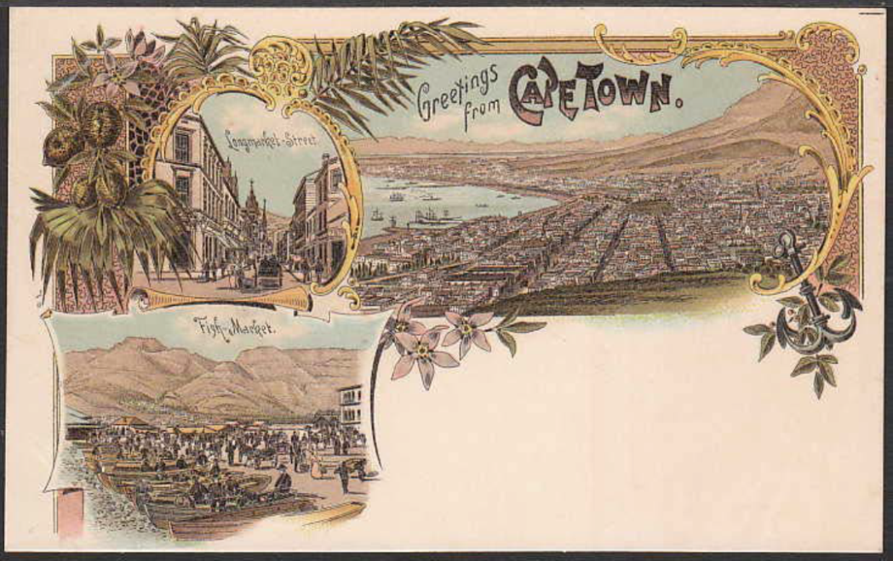
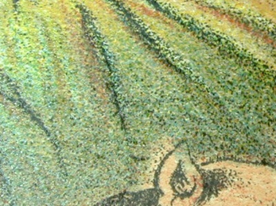
Production Methods/Techniques
  Lithography: Chromolithography - colour litho

Slide 25
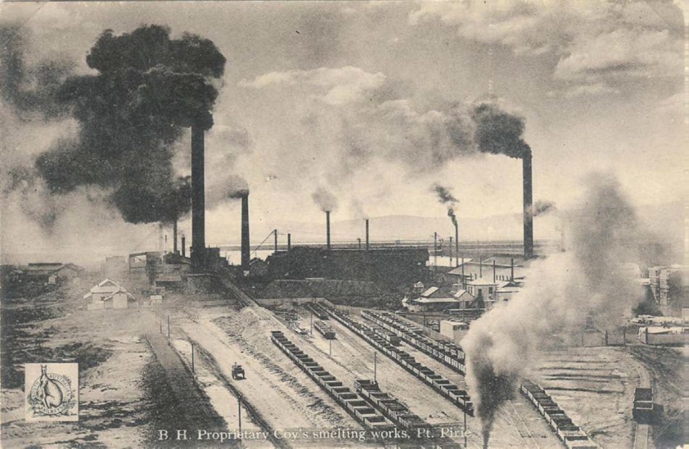
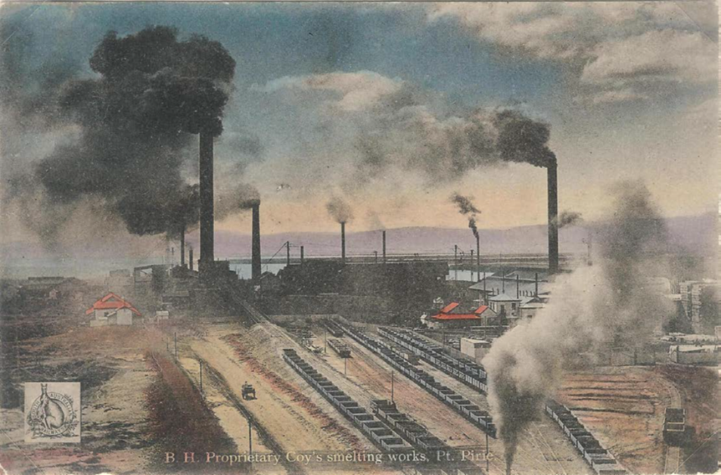
Production Methods/Techniques
  Lithography: Collotype - the dots cannot be seen, 4000 dpi
  Colour hand tinted collotype

Slide 26
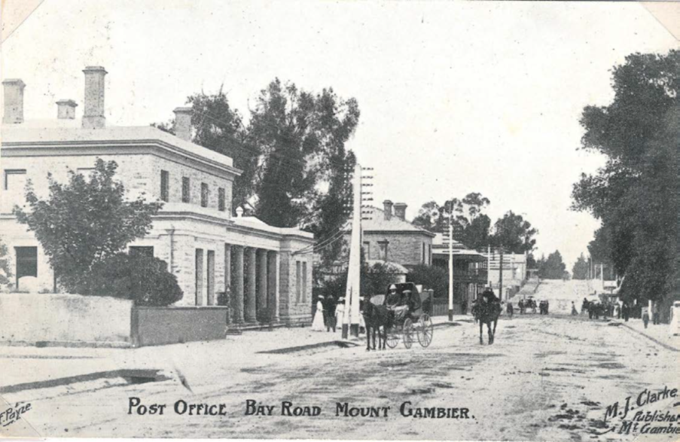
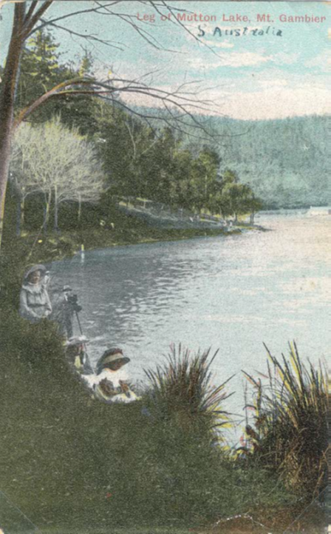
Production Methods/Techniques
Letterpress Printing - Half-tone Block
Four-colour process
(Recess, Lithography & Letterpress)

Slide 27
Condition and Rarity
Condition:
Items selected should show
the best possible quality available
for the chosen subject.
German Emperor’s standard and motto of Wilhelm ll.
Welt-Krieg card 1914-1915. Publ. Meissner & Buch, Leipzig.
Postmark 04.06.1915 Wiesbaden.

Slide 28
Condition and Rarity
Rarity:
Rarity is directly related to the difficulty
in finding such postcards,
the difficulty of acquisition.
How difficult would it be to duplicate the exhibit.
☺ The Place Blanche and the famous Red Mill
in the night time. The postcard above was sent
to Belgium on the French National Day, 14.7.1900.
Chromolithograph, published by Künzli Frères, ca 1896.

Slide 29
Presentation
The exhibitor should consider which sheet size suites the material best, and the size of frames used nationally or internationally.
Most material presents itself best on pale cream or off white paper.
Framing or matting may increase the visual impression.
Illustrations (maps, drawings, etc.) or objects, which have a direct connection to the topic or development of the storyline, may be used in limited numbers.
A good presentation influences the overall impression of the exhibit – even if the highest mark is only 5 points.

Slide 30
Thank you

