Slide 1
Some Experiences at Judging Picture Postcards Exhibits in Slovenia
Bojan BRAČIČ
Prague, August 2018

Slide 2
Exhibiting Picture Postcards has long tradition
in Slovenia.
The first regulation adopted by Slovenian
Philatelic Association arranged from Austria
and Germany and published in Nova filatelija
in 2008.

Slide 3
After acceptance of Regulation for Exhibiting
Picture Postcards by FEPA Congress in Athens,
we prepare some seminars for exhibitors
(Lojze Tomc).
I translated mentioned regulations and it was
published on organizer‘s website.

Slide 4
In Slovenia we have every fourth year
specialised philatelic exhibition MaksiRavne
(Ravne na Koroškem)
Exhibition is restricted for Maximmaphily and
Picture Postcards only.
In March 2018 there were third such exhibition.

Slide 5
Judging at MaksiRavne 2018 shows the
following problems:
Idea, plan and treatment
Most exhibits were topographical (showing town, village and its surroundings, etc.), few exhibits were thematic, only one showed other aspect – Picture Postcards creator and publisher.

Slide 6
Only half of them had the plan;
most of plans were very modest.
The main problem was treatment – no story at all or very weak story.

Slide 7
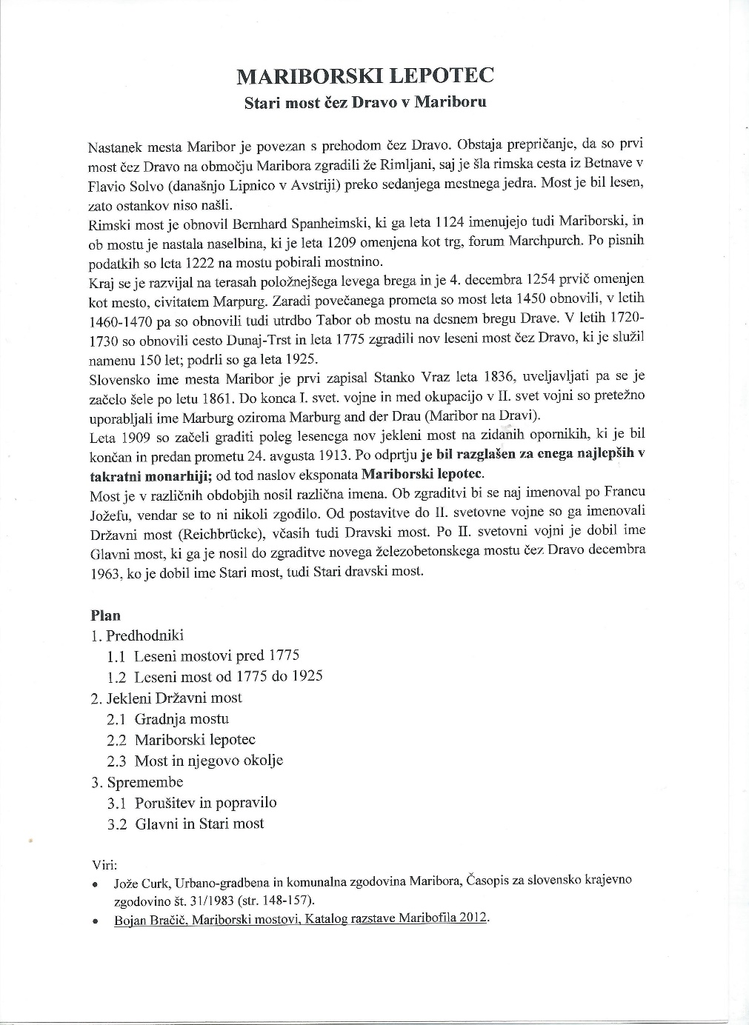
I tried to show,
how plan can be
created although
for only one frame
exhibit.

Slide 8
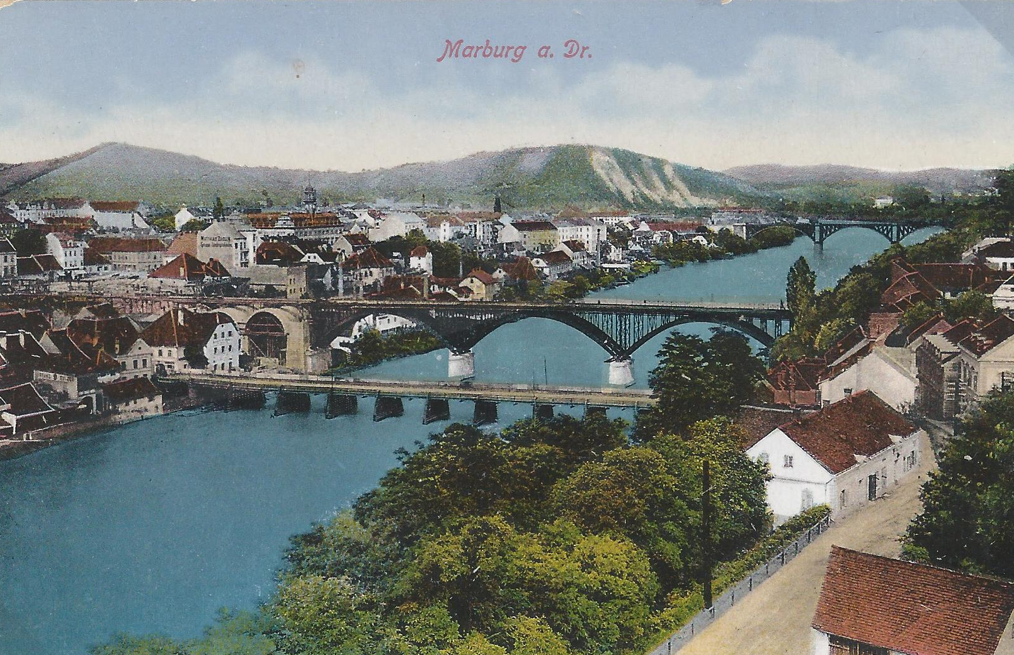
Title, plan and treatment must be in close
Connection.
Title: The Beauty of
Maribor
Subtitle: Old Bridge Over
River Drava

Slide 9
Plan: 1. Forerunners
1.1 Wooden Bridges Before 1775
1.2 Wooden Bridge from 1775 to 1925
2. State Steel Bridge
2.1 Building of the Bridge
2.2 The Beauty of Maribor
2.3 The Bridge and Its Surroundings
3. Changes
3.1 Demolish and Rebuilt
3.2 The Main and the Old Bridge

Slide 10
Knowledge and Research
Philatelic data have nothing to do with Picture postcards exhibit, but few exhibitors want to show their knowledge with them.

Slide 11
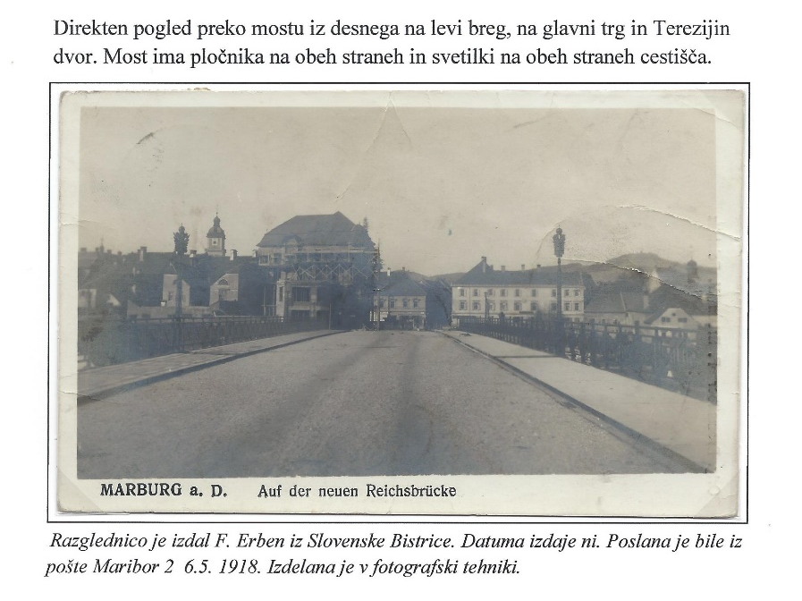
But, we can use philatelic data for installation
in time.
Topic text
Publisher
No issuing date, so
date from cancellation
Printing technique

Slide 12
Topic knowledge were mostly well documented, but the greater part of exhibits had very few information about photographer or artist and publisher.
There were no information about printing methods.

Slide 13
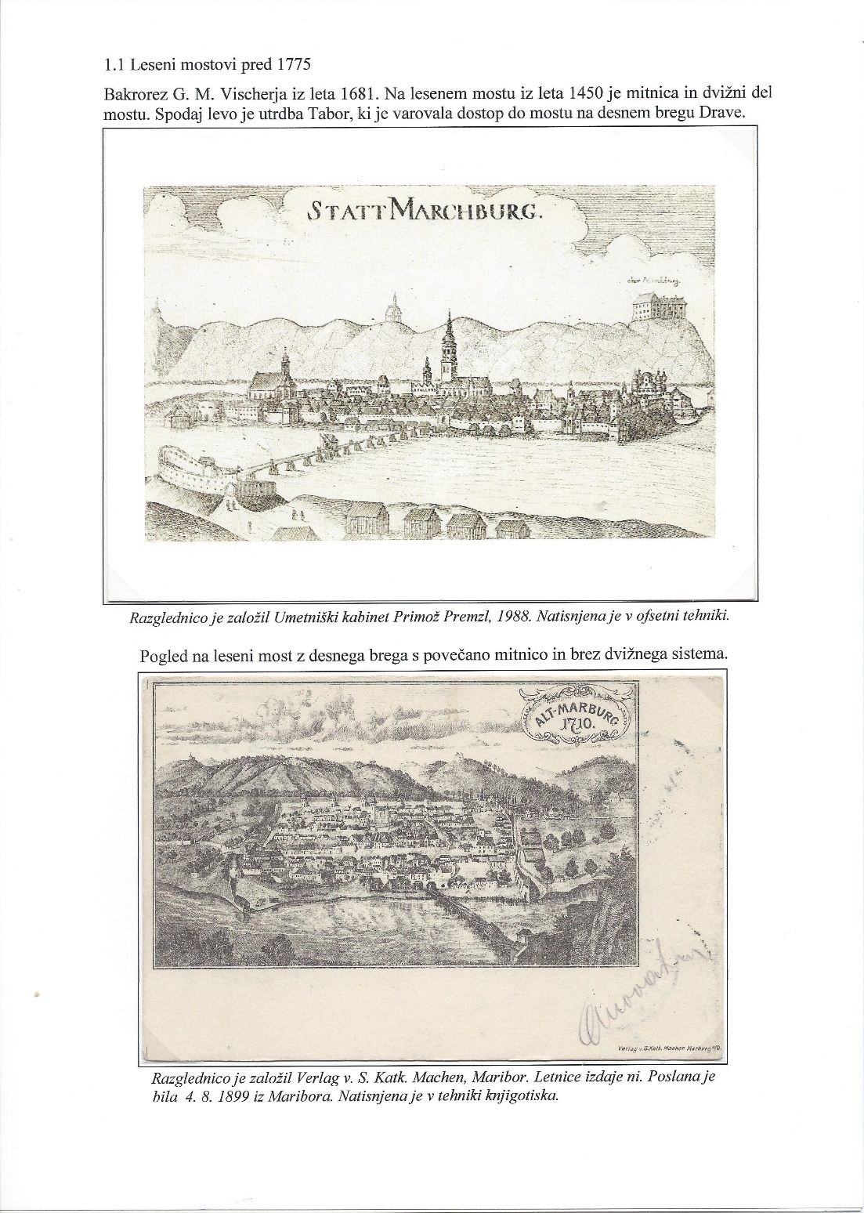
Reprints of old picture
postcards are not welcome.
This item is not reprint,
but today issue after old copper engraving.
Printing techniques are indicated at both PP.

Slide 14
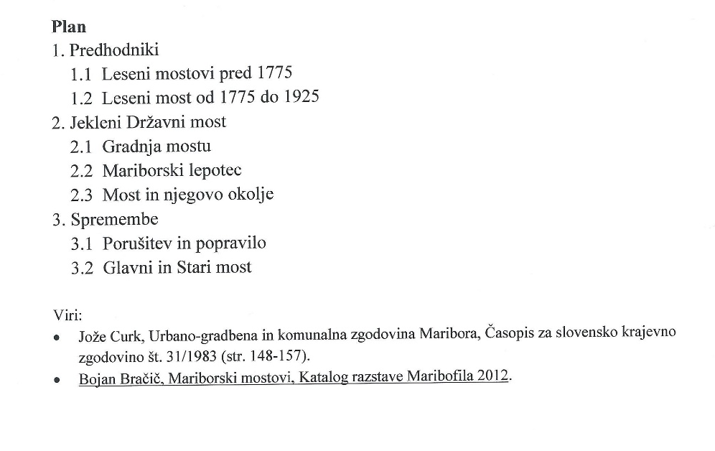
Research of
the exhibitor
about chosen
theme should
be also
indicated.

Slide 15
Thank you for your attention

