Slide 1


Slide 2
At the 2015 FEPA Congress held in Athens, were approved the Regulations for the Picture Postcard.
Since then this new Class is growing everywhere, being present in most FEPA events with an increasing interest for it.
In the 2018 FEPA Annual Meeting was formed a team , led by Birthe King with Alfred Kunz, Bojan Bračič and myself, to work on the promotion and teaching of how evaluate the Picture Postcard exhibits for jurors and exhibitors.
(*) Few weeks ago, the FIP decided to adopt it in Thailand 2018 next November

Slide 3
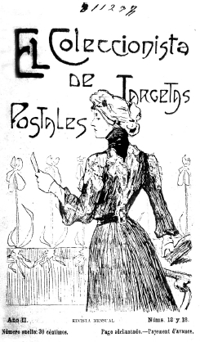
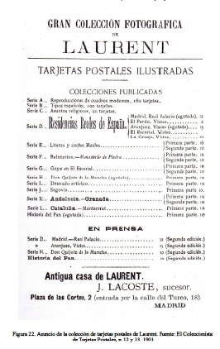
Cover pages of Spanish magazines devoted just to Collectors of Picture Postcards (1899, 1901)

Slide 4
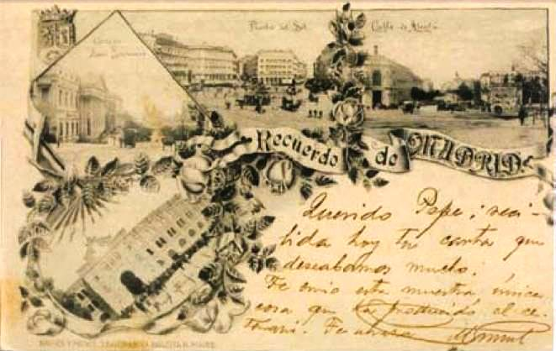
I will try to briefly explain the basics of the Regulations when judging Picture Postcards exhibits following my experience as juror during the last two years. Then, Birthe, Bojan and Fredi will treat it in depth.
Madrid, 1892

Slide 5
It is necessary the existence of an idea,
presented in the plan and developed in the collection.
The exhibitor must explain in the introduction / plan sheet how has decided to develop the matter.
Look that they are really postcards and not other types of images or reprint.

Slide 6
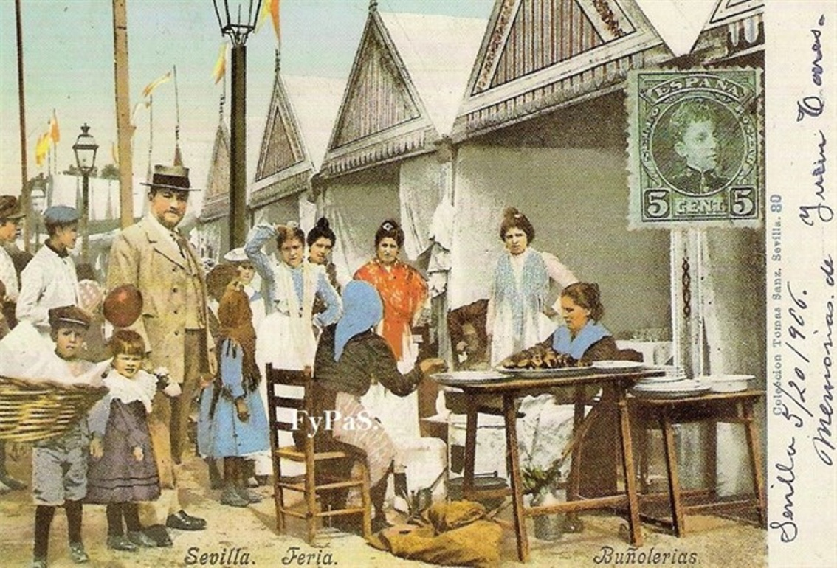
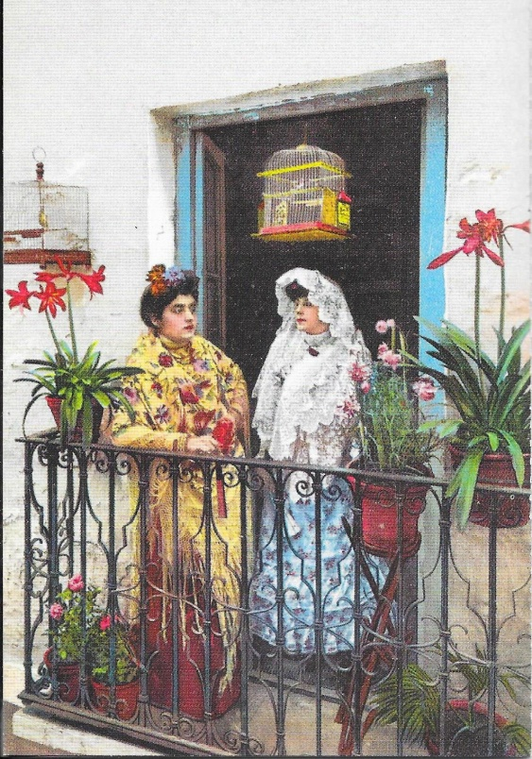
Images of the daily Seville of the beginning of 20th Century. Left: Street fritters at the local fair. Right: Ladies with typical costumes. Both are Picture Postcard coloured from black and white photos and then printed. Printer: Tomas Sanz, Seville 1905
- The important is the image of the postcards and not the philatelic particularities that may have.
- Check the knowledge that is proved by the selection and variety of the exposed material. Brief explanations of each postcard. Also on technical aspects when they are relevant.

Slide 7
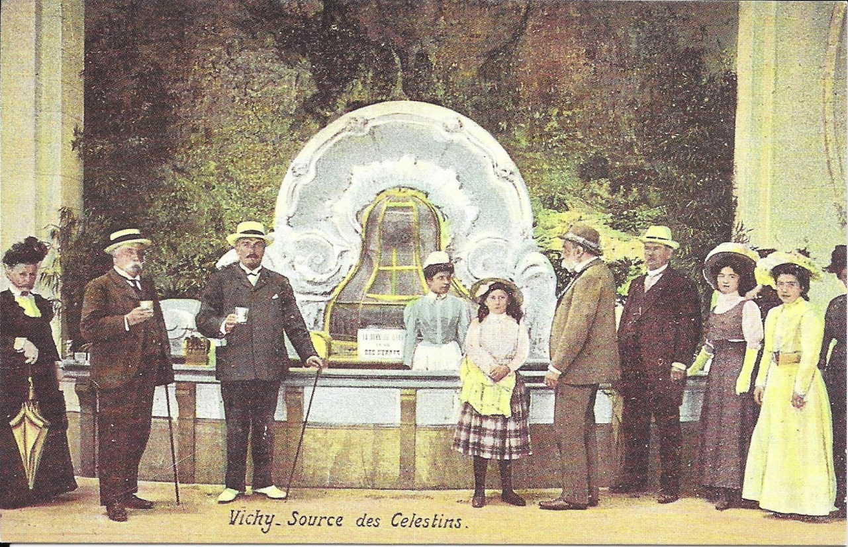
Thermal of Vichy, the Celestins fountain in 1897. Reprint made by Barclays in 1998. Reprints produced at a later time should only be shown exceptionally.
Condition: The best quality available. To be tolerant with the condition of the oldest circulated postal cards
- Rarity: Difficulty of finding those postcards.How much work would it be needed to duplicate the collection?

Slide 8
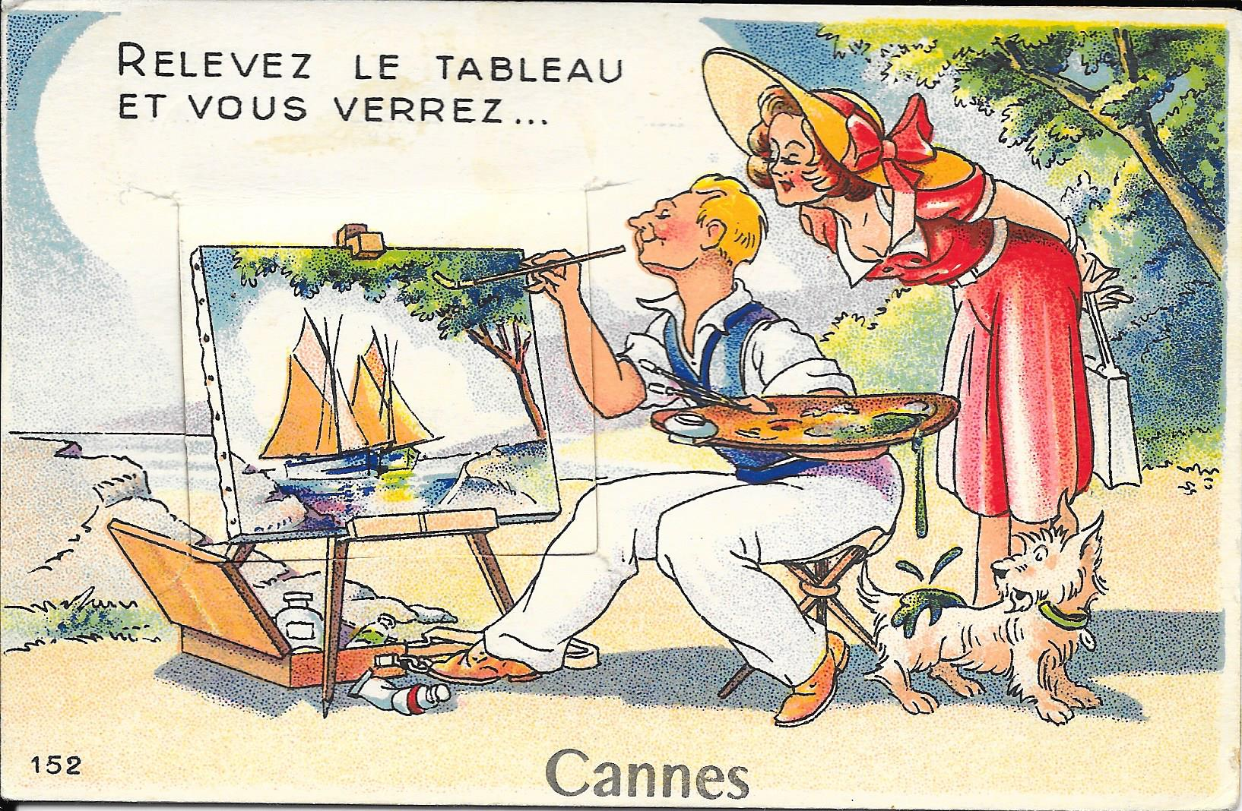
Picture Postcard promoting the touristic city of Cannes printed by Editions Gaby
edited by Artaud Pére et Fils 1948
Presentation: Attractive general printing. Varied
assembly. Occasional drawings or objects could
be present but to avoid that they filled the pages
With exaggerated colours.

